Slide 1
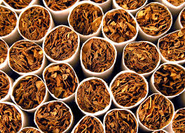
Tobacco!
Diana Senawe & Dylan Van Conant
5/24/16
Ms. McLean 4th hour
8th grade

Slide 2
What Are the street names for Tobacco?
Some names for tobacco are doof, puff, fun stacks, jiggle sticks, dope, Long rods, fat chix.

Slide 3
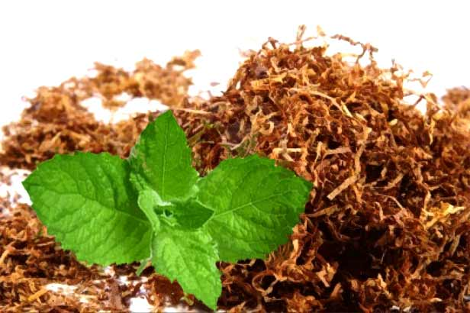
What is Tobacco?
Tobacco is a preparation of the nicotine-rich leaves of an American plant, which are cured by a process of drying and fermentation for smoking or chewing.

Slide 4
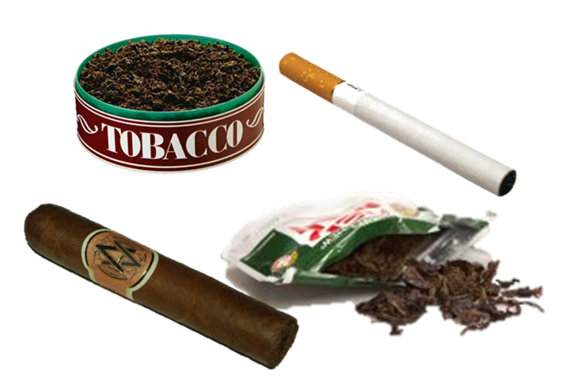
What does Tobacco look, smell, taste, and what color is it?
Tobacco looks like a shade of brown it is a type of plant that is dried. It is 0.3 to 0.5 micron. It taste sweet, salty.

Slide 5
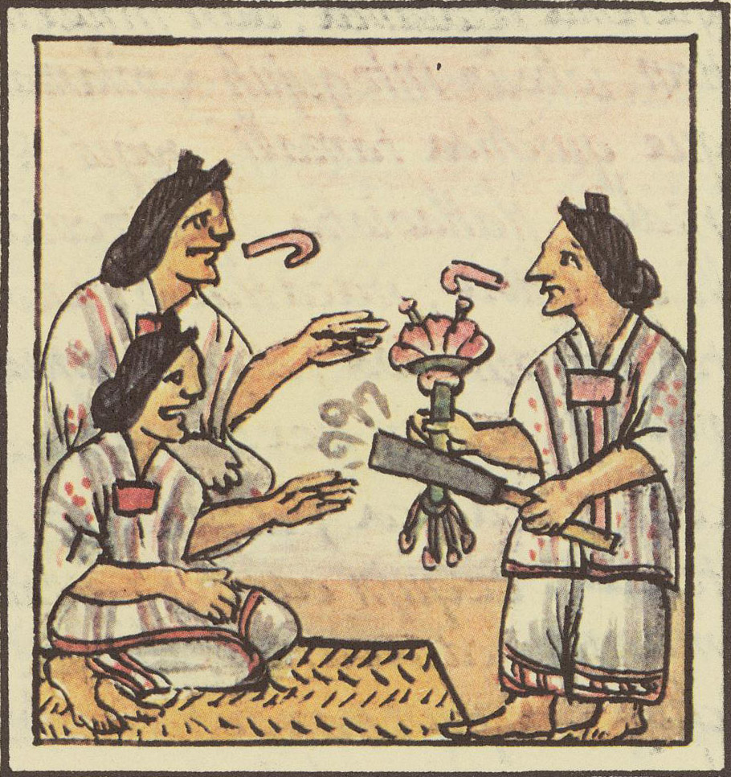
Where is it origin? How quick will it take effect and how long does it last?
It was from American Indians and before the Europeans came from England. It was used for a cash crop for the first American colony in James town. Tobacco was discovered by native people of north and south America and introduced to Europe and the rest of the world.

Slide 6
What are the short term effects?
the body responds immediately to the chemical nicotine in the smoke. Nicotine causes a short-term increase in blood pressure, heart rate, and the flow of blood from the heart. It also causes the arteries to narrow. Carbon monoxide reduces the amount of oxygen the blood can carry.

Slide 7
What are the long term effects?
It is now well documented that smoking can cause chronic lung disease, coronary heart disease, and stroke, as well as cancer of the lungs, larynx, esophagus, mouth, and bladder. In addition, smoking is known to contribute to cancer of the cervix, pancreas, and kidneys.

Slide 8
What are the legal consequences if caught using or selling?
it depends on the state if you are a tobacco vender you might be restricted to specific laws and regulations. tobacco members have to post signs at the point of sale starting. That the sale of tobacco to minors is illegal.

Slide 9
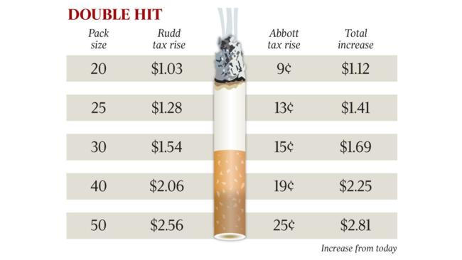
How much does Tobacco cost?
To buy tobacco it will cost about $7.00 to buy a pack of cigarettes today. The tobacco companies spend only pennies (About 6 cents) to make a pack of cigarettes.

Slide 10
Is it addictive?
Nicotine found in all tobacco products is a highly addictive drug that acts in the brain and throughout the body. Dip and chew contain more nicotine t6han the cigarettes.

Slide 11
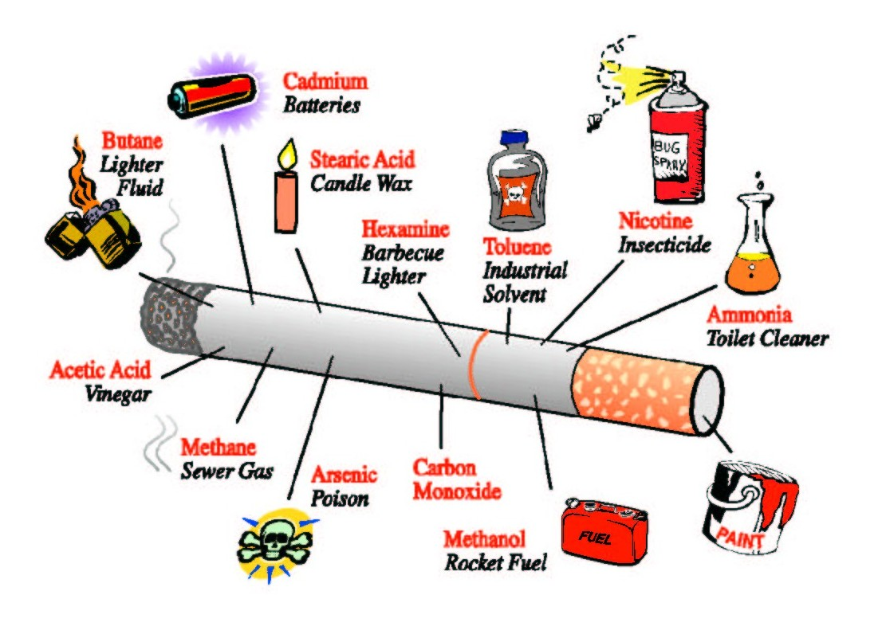
What's in Tobacco?
Carbon monoxide - car exhaust, nicotine - bug spray, tar road - material, arsenic - rat poison, ammonia – cleaning products, hydrogen cyanide – gas chamber poison. There is still so muck more.

Slide 12
YouTube video about Tobacco.
https://www.youtube.com/watch?v=mxlKS2-xZ6o

Slide 13
The sites we got our information from.
Google
healthliteracy.worlded.org
Awnser.yahoo.com
Hd.ingham.org
Legalmatch.com
Betobaccofree.hhs.gov
Intheknowzone.com

