Slide 1
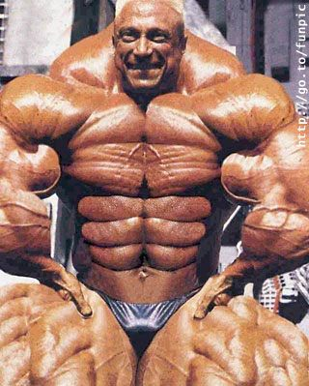
Steroids
By Matthew Timny and Alden Saado
Ms. McLean
4th Hour Health
May/25th/16

Slide 2
What are some street names/slang terms for the drug.
There are multiple terms for Steroids such as
Gear
Juice
Stackers
Roids
Pumpers
Gym candy

Slide 3
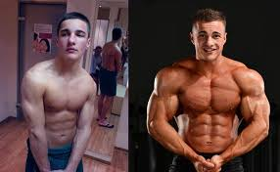
What are Steroids?
Anabolic Steroids are artificial hormones that can improve strength and muscle mass. it is common for athletes and bodybuilders to use this drug to give them a competitive advantage and/or improve their physical performance. it is illegal in the United States to possess or distribute anabolic steroids for nonmedical use
Read more: http://www.chemistryexplained.com/St-Te/Steroids.html#ixzz496UeHEFu

Slide 4
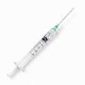
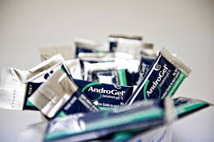
What does Steroids look like?
Steroids come in many forms
They can come in Tablets or Capsules
they can come in the form as a solution for injection
Steroids can also come in the form as gel or in patches

Slide 5
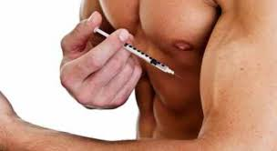
How are Steroids administered? How quick does it take effect and how long does is last?
by mouth, pellet implantation under the skin and by application to the skin (e.g. gels or patches). injection and oral administration being the most common.
Most injections typically take 24-48 hours to take full effect
Eight Weeks is the minimum
duration of a steroid cycle

Slide 6
What is it origin? How was is it made? What was it used for originally and who made it
Steroids were originally invented in the late 1930’s to treat delayed puberty. Today they are prescribed for certain types of anemia, men with low testosterone and diseases like cancer and HIV.
Anabolic steroids manufactured by pharmaceutical companies are available legally only by prescription.
In most cases the steroids used by athletes are usually stolen, smuggled, created in illegal labs or prescribed by unethical doctors.

Slide 7
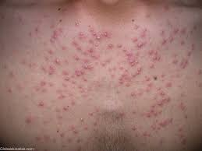
What are the short term effects?
paranoid (extreme, unreasonable) jealousy
extreme irritability
delusions—false beliefs or ideas
impaired judgment
Acne
Fatigue
Trouble Sleeping

Slide 8
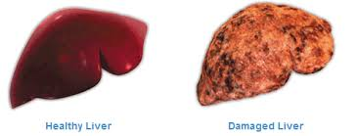
What are the long term effects?
kidney problems or failure
Fertility issues.
liver damage
Elevated blood pressure.
enlarged heart, and changes in blood cholesterol, all of which increase the risk of stroke and heart attack, even in young people

Slide 9
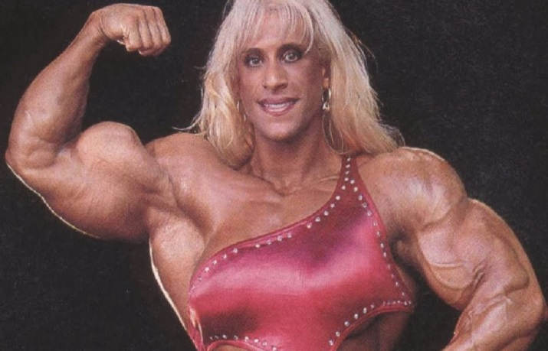
These are some common effects of using steroids in each sex
In women
In men
disrupted menstrual cycle
permanent infertility
severe acne
excessive facial hair
deepened voice
stunted growth
accelerated puberty
abnormal sexual development
development of breasts
liver disease/liver cancer

Slide 10
What are the legal consequences if caught using this drug?
Simple possession of illicitly obtained anabolic steroids carries a maximum penalty of one year in prison and a minimum $1,000 fine if this is an individual’s first drug offense
If this is the second felony drug offense, the maximum period of imprisonment and the maximum fine both double.
Steroids are illegal
unless given a prescription.

Slide 11
What is the cost?
Since steroids come in many different
forms their price varies.
In most cases, illegal steroid prices can range from 35-100 dollars.

Slide 12
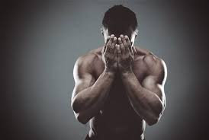
Is it addictive?
Even though anabolic steroids do not cause the same high as other drugs, they can lead to addiction.
An undetermined percentage of steroid abusers may become addicted to the drugs, as evidenced by their continued abuse despite physical problems and negative effects on social relations

Slide 13
Some Symptoms OF WITHDRAWAL
Weakness
fatigue
decreased appetite
weight loss
nausea
vomiting
diarrhea
abdominal pain

Slide 14
These Videos Provide Some Good Information on Steroids

Slide 16
Bibliography
http://www.deadiversion.usdoj.gov/pubs/brochures/steroids/lawenforcement/
http://drugabuse.com/library/the-effects-of-steroid-use/
https://www.drugabuse.gov/publications/drugfacts/anabolic-steroids
https://www.drugabuse.gov/publications/research-reports/anabolic-steroid-abuse/are-anabolic-steroids-addictive
http://rheuminfo.com/steroid-cortisone-injections-detailed-information
http://www.soberrecovery.com/addiction/steroid-street-names/
http://www.chemistryexplained.com/St-Te/Steroids.html

