Slide 1
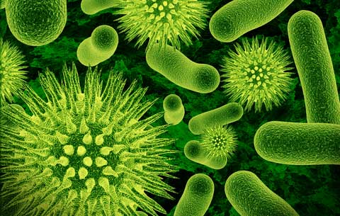
Preventing the Spread of Disease

Slide 2
Disease
Any condition that interferes with the proper functioning of the body or mind.
Communicable Disease
A pathogen/disease that can be passed to a person from another person, animal, or object.

Slide 4
Acute disease
An acute disease is a short-lived disease, like the common cold.
Chronic disease
A chronic disease is one that lasts for a long time, usually at least six months. During that time, it may be constantly present, or it may go into remission and periodically relapse. A chronic disease may be stable (does not get any worse) or it may be progressive (gets worse over time). Some chronic diseases can be permanently cured. Most chronic diseases can be beneficially treated, even if they cannot be permanently cured.

Slide 5
Pathogens (Germs) disease causing organisms that cause harmful infections.
Pathogens | Description | Diseases
Bacteria | One cell organisms Treated with antibiotics Some bacteria can be helpful | Pink eye, whooping cough, strep throat, tuberculosis, Lyme disease, diphtheria, cholera, pneumonia
Viruses | Smallest pathogen Can not be treated or cured with antibiotics | Cold, Flu, Measles, Herpes, HIV, Hepatitis, fever, polio, rabies, mumps, chicken pox, Influenza, pneumonia, West Nile Disease
Fungi | Complex organisms Feed on organic material Warm & Moist environments | Ringworm, athlete’s foot
Protozoa | One cell organism | Malaria, Dysentery
There every where!!!!

Slide 6
How do Pathogens Spread?
Direct contact with others
*shaking hands, kissing, sexual contact.
Indirect contact with others
*sharing utensils, body piercings, tattoos, contaminated needles.
3. Contact with contaminated food and water.
Contact with animals or insects.
*mosquitoes-West Nile disease, ticks-Lyme disease, etc.

Slide 7
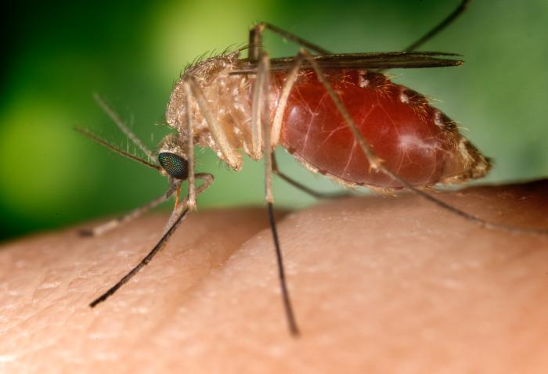

Slide 8
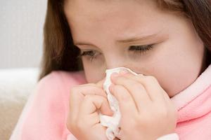
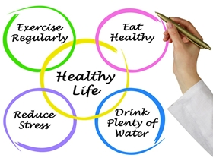
Prevention
You can carry a pathogen and not know it.
Germs are easily spread.
Stay home if ill.
Practicing good hygiene (cleanliness).
Wash your hands immediately.
Cover your mouth when sneezing or coughing.
Do not share eating utensils, drinks, food, or
personal items.
Take all medicine prescribed to finished.
Prepare and store food safely, wipe countertop with clean sponge and cloths.
Keep environment clean.
Eat nutritious and healthy foods and drinks.
Enough sleep.
Physical Activities.

Slide 9
The Body’s Defenses Against Infection

Slide 10
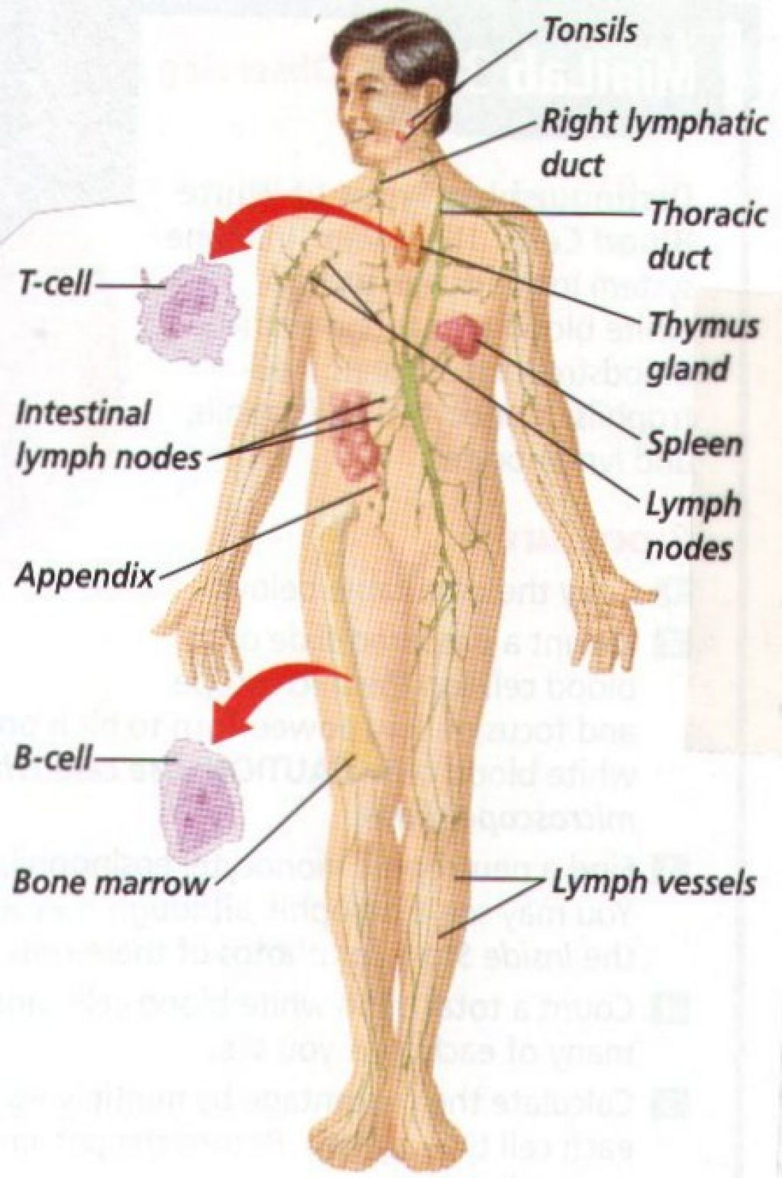
Immune System
Body defense system.
Cells, tissue, and organs that fight off pathogens and diseases.

Slide 11
Immunity
your body’s ability to resist the germs that cause a particular disease.
Everyone is born with a natural immunity.
Mother’s antibodies are passed on to the baby through Then baby start to build it own antibodies.
Vaccine –is a preparation of dead or weakened pathogens that causes the immune system to produce antibodies for certain diseases.
(Polio, measles, mumps, chicken pox-once. Hepatitis B-3 times. Whooping Cough-6 times. Tetanus shot-every year.)
Help protect the body against certain communicable diseases. Not only you but others.

Slide 12
5 Major Barriers
1. Tears
Protect eye from dust and pathogens. Contain chemicals that kill pathogens.
2. Mucous Membranes
Soft skin in nose, mouth, eyes, and other body openings. Traps pathogens in mucus and expels them.
3. Saliva
Wash germs away from teeth. Contain chemicals that kill pathogens.
4. Skin
Tough outer protective surface that keep pathogens from entering blood.
Stomach Acid
Gastric juice is produced to kill many pathogens that make it past the saliva and mucus membranes of your mouth.

Slide 13
Nonspecific Immune Response
Inflammation-body’s response to injury or disease, resulting in a condition of swelling, pain, heat, and redness.
Brain sends signals telling white blood cells to rush to the affected area and destroy the pathogens.
If pathogens spread, your body temperature may rise and cause a fever. A higher body temperature makes it harder for pathogens to reproduce.
A fever also signals the body to produce more white blood cells.

Slide 14
Specific Immune Response
Some pathogens can survive the body’s nonspecific response. When this happens the body sets in motion a specific response.
Our immune system can recognize pathogens it has already battled. It then send these specific white blood cells to attack again.
The second response is much quicker than the first.

Slide 15
Lymphatic System
A secondary circulatory system that helps the body fight pathogens and maintains its fluid balance.
Fluid in lymphatic system is lymph.
White blood cells in fluid (lymph) are lymphocytes.
2 kinds lymphocytes-B cells and T cells.
B cells-Bone Marrow T cells- Thymus Gland
Macrophages-attach themselves to invading pathogens and destroy them. Help lymphocytes recognize the invader and prepare for future attacks.

Slide 16
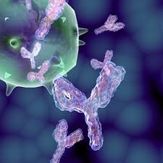
Antibodies and Antigens
Antigen –is any substance released by invading pathogens.
Antibodies- proteins that attach to antigens, keeping them fro harming the body. Immune system responds to these antigens by producing antibodies.
B cell- produces a specific antibody for each specific antigen. If the pathogen invades the body again, these antibodies are ready to attack.
T cell- stimulate production of B cells or attack pathogens directly.

Slide 17
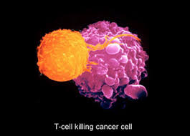
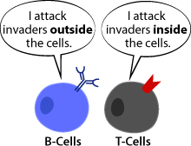
T Cells
Types
Helper cells-activate the production of B Cells
2. Killer cells-attach to invading pathogens and destroy them.

Slide 18
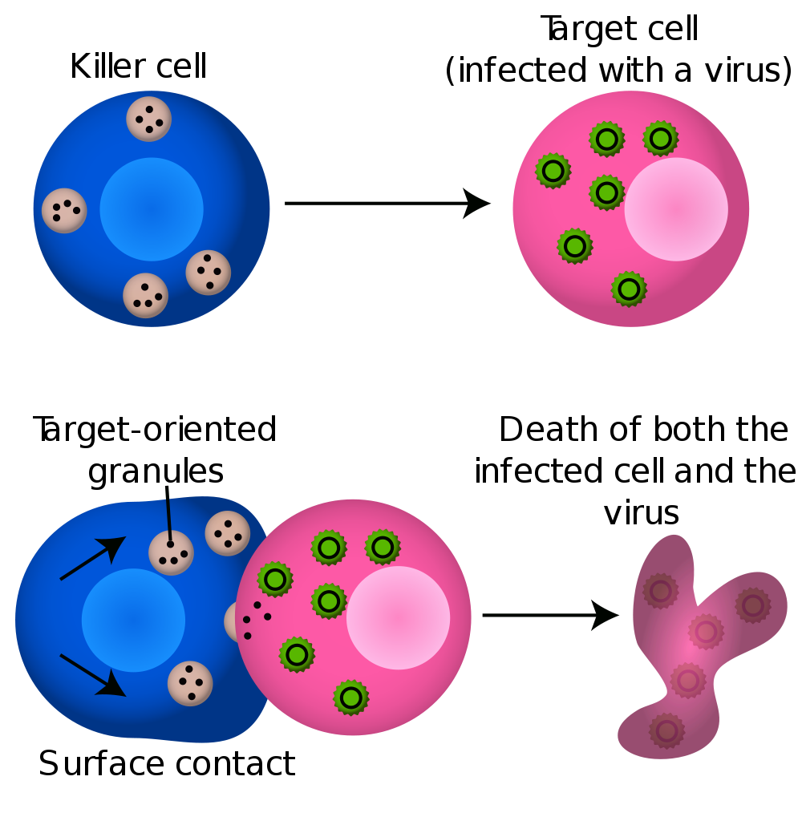

Slide 19
Common Communicable Diseases
Contagious Period- the length of time that a particular disease can be spread from person to person. Every communicable disease has a contagious period.

Slide 20
Mononucleosis
A viral disease characterized by a severe sore throat and swelling of the lymph glands in the neck and around the throat area.
Most commonly infects teens and young adults.
Known as the “kissing disease”.
It is spread through contact with the saliva of an infected person. Or sharing contaminated eating utensils and drinking glasses.

Slide 21
Colds
Most Frequent-Cold.
Spread Direct or Indirect.
Rest, Fluids, and over counter medicines.
Stay at home for at least 24 hours.
Easy to spread.

Slide 22
Flu
Fever, chills, fatigue, headache, muscle aches, and respiratory problems.
Influenza
Cause by 3 types of viruses, each with several different strains.
Most strains relatively harmless but some can be serious.

Slide 23
Hepatitis
Viral disease of the liver. Yellowing of the skin and the whites of the eyes. Loss of appetite, weakness, lack of energy, headaches, sore throat.
3 types of the virus – Hepatitis A, B, and C.
Hepatitis A- common in poor sanitation. Spread through food or water that has been contaminated by human waste. It can also, enter through an open wound.
Hepatitis B and C -spread through contact with contaminated blood or other body fluids.
A & B –can be prevented by a vaccine, no cure.
C –medications can help control infection but no cure.

Slide 24
Other Common Communicable Diseases
Tuberculosis-(TB) is a bacterial disease that usually affect the lungs. Spread through the air. Fever, fatigue, weight loss, coughing blood.
Pneumonia- serious inflammation of the lungs. Fever, chills, and difficulty breathing. People who have other disease are especially vulnerable to pneumonia. Direct or indirect contact. Can be caused by both virus or bacteria. Bacteria treated with antibiotics.
Strep Throat-is a sore throat causes by a bacteria. Red and painful throat, fever, and swollen lymph modes in the neck. Headaches, vomiting maybe. Direct or indirect contact. Untreated it can lead to kidney or heart damage. Bacteria treated with antibiotics.

Slide 25
STD’s (Sexually Transmitted Diseases)
Spread through sexual contact such as vaginal intercourse, anal sex, and oral sex.
STI-sexually transmitted infections. Same as STD.
¼ of all new cases of STD’s appears in teenagers between 15-19. Many do not even know it.
A person can be re-infected if he or she has sexual intercourse with an infected person. Both partner should be treated.
STD’s are Preventable!!!!!

Slide 26
Chlamydia
Bacteria called chlamydia trachomatis.
Curable with antibiotics.
May not show early symptoms. 80% of infected woman show no symptoms.
Frequently leads to sterility if it goes untreated.
A person can be re-infected if he or she has sexual intercourse with an infected person.
Transmitted by intimate sexual contact. Infected mother to baby during birth.

Slide 27
Gonorrhea
Bacteria called Neisseria gonorrhea. Clap, drip, or GC other names.
Curable with antibiotics.
May lead to sterility for both man and women if untreated.
Most women do not have symptoms.
Transmitted by sexual contact. Mother to baby during birth.
Major cause of PID (Pelvic inflammatory disease), a serious infection of the Fallopian tubes.

Slide 28
Syphilis
Bacteria called spirochete-treponema pallidum.
Curable, antibiotics. Both sex partners must be treated or they will continue to re-infect each other. Is not cured without treatment, even though the sore/rashes will go away on their own.
A sore (chancre –SHANK’er) usually painless, and or a variety of rashes appears. Spread if the sore or rash is touched, even if the contact is not with the genitals. Sores may not be easily seen.
Transmitted by sexual contact, mother to baby during pregnancy.

Slide 29
Genital Warts
Virus called HPV (Human Papillomavirus).
Not curable.
Treatable by removing the warts, which may return.
Virus can be present without the wart’s presence.
Flesh color and look like cauliflower around the genitals, rectum, or throat.

Slide 30
Hepatitis B
Virus called HBV.
Not curable. Only STD that can be prevented with vaccinations.
Found in blood and other body fluids like HIV.
Transmitted by sexual contact, sharing needles, blood contact, human bites, mother to baby during pregnancy.
Can lead to liver cancer, and even death.

Slide 31
Herpes
Virus
Not curable, yet symptoms are treatable, but they usually return periodically.
Often not visible. Or a forms a blister.
Spread by contact with the area where the sore is going to appear and with the sore itself until it is completely healed. Mother to baby during birth. Intimate sexual contact.

Slide 32
HIV
Virus called Human Immunodeficiency Virus.
Not curable. Prescription drugs can slow down the progression of the disease.
Transmitted by sexual contact, mother to baby before, during, and after birth. Contact with body fluids (blood, semen, and vaginal secretions). Fluids enter the body of the uninfected person through mucous membranes, or cutes, or sores in the skin.

