Slide 1
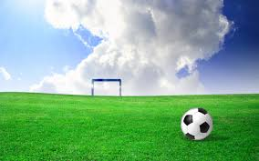
Soccer
Most popular game in the world.
Oldest known team sport.
Most countries soccer is known as football..

Slide 2
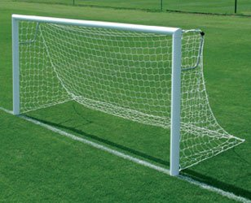
Object of the Game
Score more goals than the opposing team.
Goal- scoring a goal is made when the entire ball crosses the goal line, between the goal posts and under the crossbar, whether on the ground or in the air.
A Goal is worth 1 point.

Slide 3
Field

Slide 4
Players Two teams of 11 players
Backs (3) and (1) Goalkeeper
play on the defensive half of the field, in front of their own goal. They mark the other team forwards. They work to prevent the attacking team from scoring.
Midfielders (4)
play in the middle of the field between the backs and the forwards. Usually the most active players. They support both defense and offense.
Forwards (3)
play on the offensive half of the field and are responsible for most of the scoring.

Slide 5
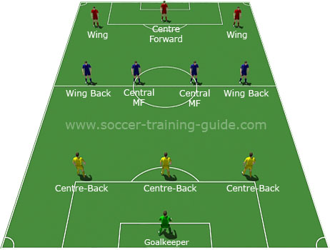

Slide 6
How is the game started?
A kickoff is used to start the game or after a goal is scored.
Defending players stand outside center circle.
Ball is placed on halfway line in middle of center circle.
A goal can not be directly scored from here.
Kicker can not touched the ball again till another player touches it.
The ball must roll one circumference forward before touching another player.

Slide 7
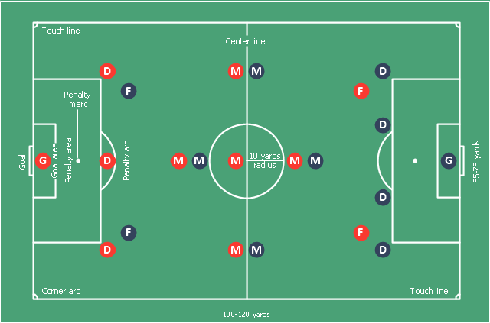
M
F
https://youtu.Fe/Oxpmr1s90dI
F

Slide 8
Handling
The goalkeeper is the only player who may handle the ball with their hands (only in his/her penalty area).
Except during a Throw-in, when field players may use their hands.
Penalty for using hands is called Handball.
*The opposing team is given the ball at the point of contact . (Direct Kick)
*Contact is from the shoulder to the finger tips.

Slide 9
Handball
https://youtu.be/CUASGLxFPoY

Slide 10
Throw-in
When the ball goes over the touchline (sideline).
Opposing team throws in the ball behind touchline at point of exit.
Two hands behind and overhead, keeping both feet on the ground. Drag the back foot.
Get the ball back into play as quickly as possible while maintaining possession.
Aim the ball at teammates feet or into an open space ahead of teammate.

Slide 11
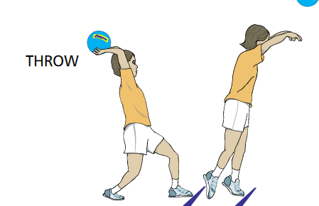
https://youtu.be/Oxpmr1s90dI

Slide 12
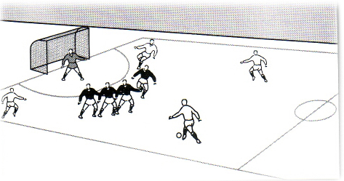
Direct Kick
Is awarded if a player kicks, strikes, trips, holds, pushes, handball, charges an opponent.
Direct Kicks are taken at the spot they occurred and can be scored directly.

Slide 13
Indirect Kick
Is awarded if a player obstruct a player without trying to play the ball.
Dangerous play.
Goalie interference.
Wasting time.
Unnecessary roughness.
Unsportsmanlike conduct.
Foul language.
Offside's.
Indirect Kick must be touched by a one other player before scoring. They are taken at the spot they occurred.

Slide 14
Penalty Kick
Is an infraction by a defending player who is in his own penalty area.
All players except the kicker & goalkeeper must stand outside the penalty area until the kick is taken.
Kick is taken from penalty spot, must be played forward.
Goalkeeper must stay on goal line without moving his feet, until kick is taken.
Direct Kick.

Slide 16
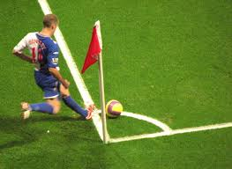
Corner Kick
Is when a defending (Defensive) player is the last person to touch the ball before it passes over the goal line.
An offensive player take the kick from the closest corner.
Direct Kick.

Slide 17
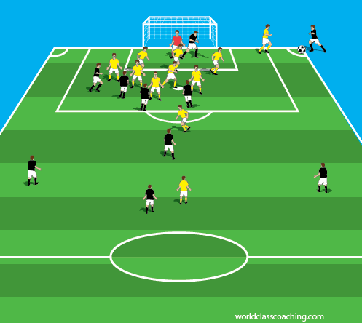

Slide 18
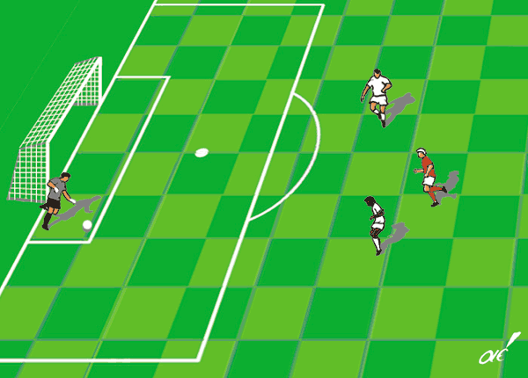
Goal Kick
When an offensive player is the last person to touch the ball before it passes over the goal line.
Goalkeeper kicks or throws the ball out from within the goal area.
Indirect kick.

Slide 19
Offside's
A player is offside's unless there is two opponents closer to the goal than him.
Exceptions:
If you are on your own half of the field.
If the opponent touched the ball last.
On a goal kick, corner kick, throw-in.
Indirect Kick

Slide 20
Moving the Ball
Dribble
Pass
Shoot -quickest way to advance the ball.

Slide 21
Dribbling
Most basic of all soccer skills.
Kick the ball with both feet ever so lightly without losing control at a comfortable speed for you.
Touching the ball with the inside of your shoes, for the most part, for better control.
Don’t look down.
3 Sweet Spots –inside, outside, shoelaces.
NO toes!!!!
https://youtu.be/hI5LI2H9GR4

Slide 22
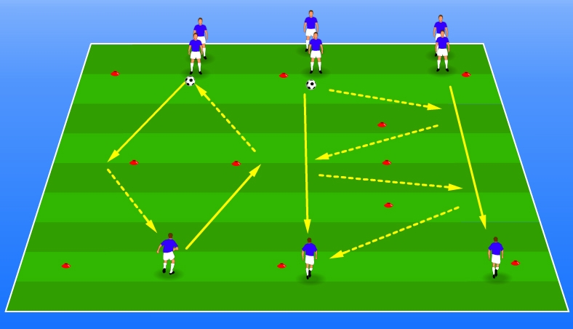
Passing
Kick pass with using the 3 sweet spots.
Pass diagonal and ahead of your teammate.
https://youtu.be/XIWAudNVooI

Slide 23
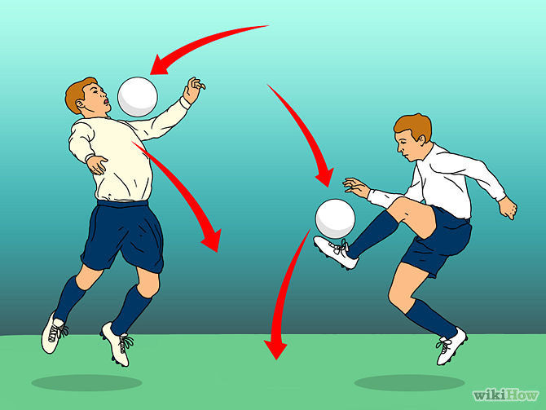
Trapping
A play to get an oncoming ball under control by using feet, legs, or body.
https://youtu.be/V6JbOjYoTf8

Slide 24
Vocabulary Words
Defense –defending or protecting one’s goal.
Offense- has the ball and is trying to score.
Infraction-Breaking the rules (violation, error,penalty or a foul).
Possession- has control of the ball.
Sportsmanship-Conduct becoming to one participating in a sport. (Fairness, Respect for one’s opponent, and winning, and losing graciously).

