Slide 1
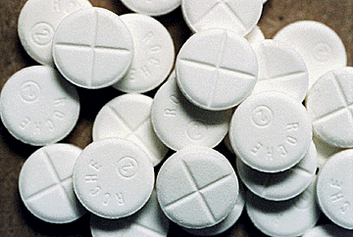
Rohypnol
Kaitlyn Hanna
Rosemary Yousif
Sama Chowdhury
Ms. McLean
Health -4th Hour
December 19,2016

Slide 2
Slang Names
R2
Forget Me Pill
Date-Rape Drug
Roofies
Rope
Rophy
Circles
Mexican Valium
Rib
Roach-2
Roopies

Slide 3
What is it?
The drug is an Benzodiazepine.
Rohypnol was used in treatment of insomnia and used as pre-surgery medication in 50 countries besides the U.S.
Rohypnol is similar to valium but 10x stronger then it.
Generally comes in 0.5 mg or 1.0 mg tablets, which are generally ground up and mixed into drinks.
Benzodiazepines are a class of psychoactive drugs

Slide 4
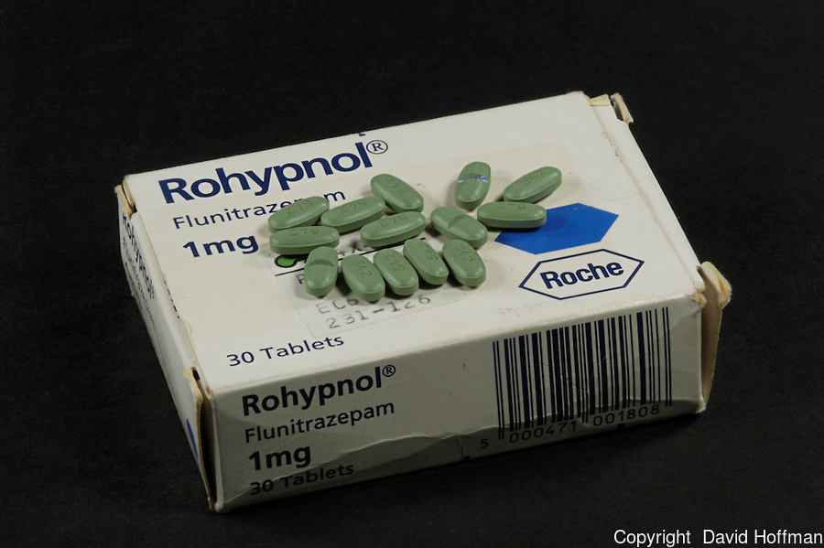
What does it look like?
A small white tablet with no taste or odor when dissolved in a drink.
It has no smell or taste, it is normally a white or oliver-yellow color pill.
It generally comes in 0.5 mg or 1.0 mg tablets.

Slide 5
How is it administrated and how quick will it take effect and how long?
It can be swallowed an pill, dissolved in an drink, or snorted.
It takes effect in 15-20 minutes, the effects last for 4-6 hours, but some residual can be found to last up to 12 hours or more.

Slide 6
What is it’s origin?
It was produced throughout Europe and some Latin-American countries thought the mail and other delivery services.
Rohypnol was used in treatment of insomnia and used as pre-surgery medication in 50 countries besides the U.S.
Created by Roche in 1957.

Slide 7
Short term effects
Headaches
Vomiting
Impaired coordination, incapacitation
Blackouts (when combined with Alcohol)

Slide 8
Long term effect
Liver Damage
Slow pulse or breathing
Death
Memory Impairment
Decreased blood pressure

Slide 9
What are legal consequences if caught using/selling it?
Under federal law, a person convicted of possession/selling of Rohypnol with intent to distribute it faces a sentence of not less than 10 years and up to life in prison, a fine up to $4,000,000, or both.

Slide 10
What is the cost?
A dose of Rohypnol generally costs between $2 and $5 but can go up to $20 or $30 depending on seller.

Slide 11
Is it addictive?
Yes. Rohypnol can cause physical dependence. Physical and psychological dependence can develop within a few weeks, addiction is very easy to achieve because of this.

Slide 12
Bibliography
https://www.drugs.com/illicit/rohypnol.html
http://www.drugfreeworld.org/drugfacts/prescription/rohypnol.html
http://www.drugfree.org/drug-guide/rohypnol/?gclid=CIe3wqr51dACFYY1aQodSbUHpw
http://www.criminaldefenselawyer.com/resources/criminal-defense/drug-charges/possession-rohypnol-a-criminal-case
http://www.911rape.org/rape-drugs/rohypnol/effects-of-rohypnol

