Slide 1
Eating Disorders
Haley Berich
Dietetic Intern, Harper University Hospital

Slide 2
Eating Disorder: “an extreme and damaging eating behavior that can lead to sickness and even death”

Slide 3
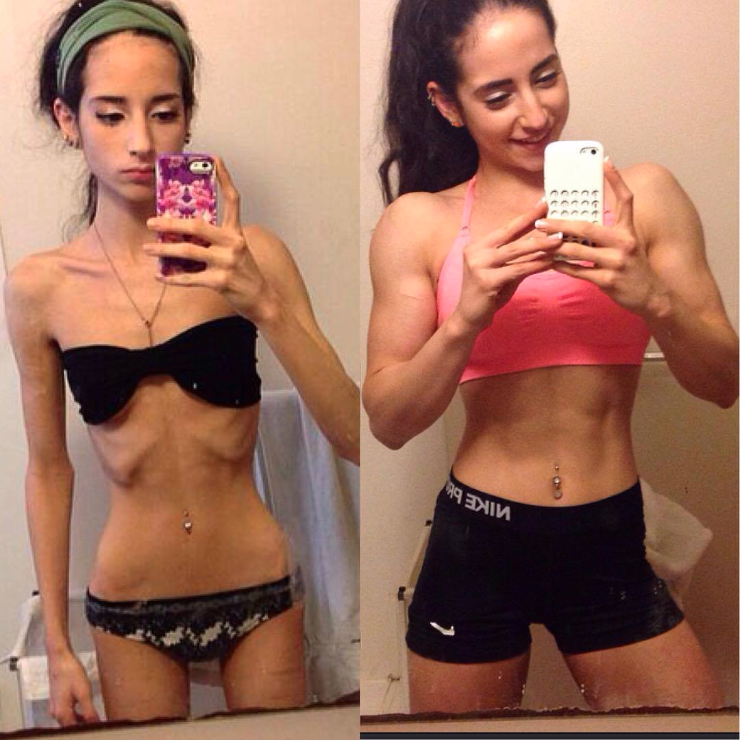

Slide 4
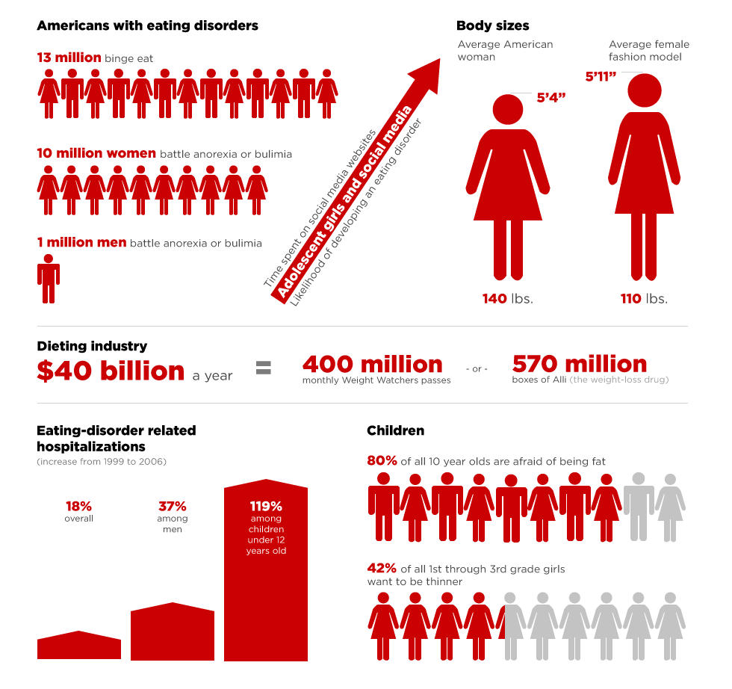

Slide 5
Types of Eating Disorders
Binge Eating Disorder
Anorexia Nervosa
Bulimia Nervosa
Eating Disorder Not Otherwise Specified
Diabulimia

Slide 6
Binge Eating Disorder
Compulsive over-eating
Eating when not hungry
Eating to a point of discomfort
Most common eating disorder
Often linked to obesity
Obesity: “weighing more than 20% higher than what is appropriate for their height, age, and body frame”
BMI: body mass index

Slide 7
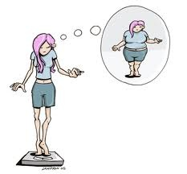
Anorexia Nervosa
Inadequate/extremely limited food intake
A fear of food and/or gaining weight
Obsession with weight
Self-esteem based on body image
Distorted body image

Slide 8
Bulimia Nervosa
Characterized by over eating followed by purging
Purge behavior varies
Vomiting
Damage to mouth or throat
Laxative abuse
Over exercise
Typically normal body weight

Slide 9
Difference between bulimia nervosa and binge-eating disorder
Bulimia nervosa and binge-eating disorder are both characterized by over-eating, however, people with bulimia nervosa also participate in purging behaviors

Slide 10
Eating Disorder Not Otherwise Specified
A person showing patterns of disordered eating but does not fit within the diagnostic criteria of previously defined eating disorders

Slide 11
Diabulimia
An eating disorder that only affects people with type 1 diabetes
Diabetes: metabolic disorder affecting the body’s ability to use glucose (sugar)
Pancreas produces insulin
Insulin helps move glucose into the cells for energy
Type 1 vs. type 2 diabetes
Diabulimia is characterized by misuse of insulin medication
Does not have a specific diagnosis yet

Slide 12
Signs of an Eating Disorder
Some symptoms are unique to one type of eating disorder
Some symptoms over lap between different types
See handout

Slide 13
Treatment Options and Coping
Hospitalization – inpatient
Unstable vital signs, complications with other medical conditions, rapidly worsening symptoms, suicidal thoughts or actions
Residential
Patient is medically stable, but psychologically unstable
Partial Hospitalization
Medically and psychologically stable, but require daily medical monitoring or participating in binge eating or purging behaviors
Outpatient
Patient is medically and psychologically stable, and does not require daily medical monitoring
Participate in group or individual therapy, but can live independently

Slide 14
Resources
http://nedawareness.org/
www.eatright.org
http://www.scandpg.org/disordered-eating/

