Slide 1
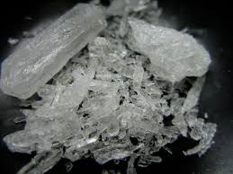
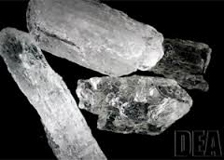
Methamphetamine
Myra Gifford & Angelina Ajja
Friday, May 27, 2016
Ms. McLean-Health
4th Hour

Slide 2
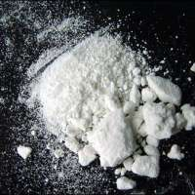
Street Names
“Crank”
“Speed”
“Blade”
“Cinnamon”
“Hot ice”
Combined With Other Drugs
“Twister”
“Fire”
“Biker Coffee”

Slide 3
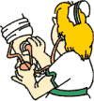
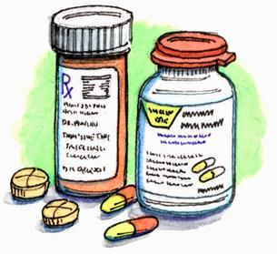
What Exactly Is It?
Methamphetamine is a synthetic drug with more rapid and lasting effects than amphetamine
Used illegally as a stimulant and as a prescription drug to treat narcolepsy and maintain blood pressure.

Slide 4
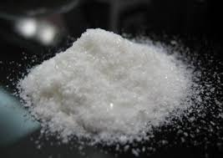
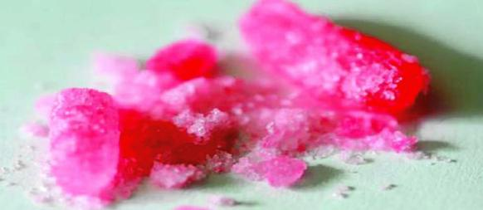
What Does Meth Look Like?
Crystalline white powder
Odorless
Bitter tasting
Dissolves easily in water or alcohol
Other colors of powder can be brown, yellow-gray, orange, and even pink.
Can be compressed into pull form
Crystal meth comes in clear, chunky crystals, resembling ice

Slide 5
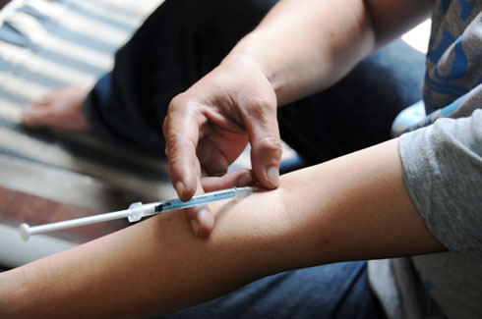
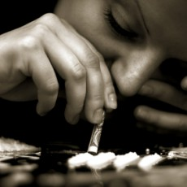
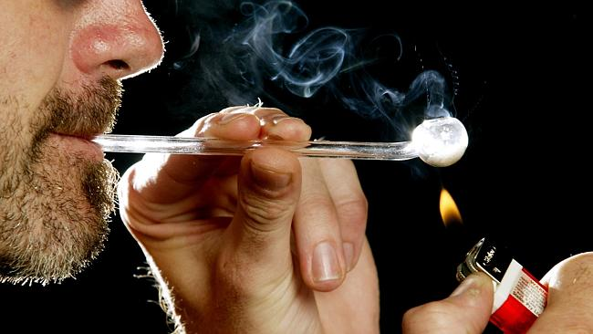
How Is It Administered?
Injected
Taken orally
Inhaled
Snorted

Slide 6
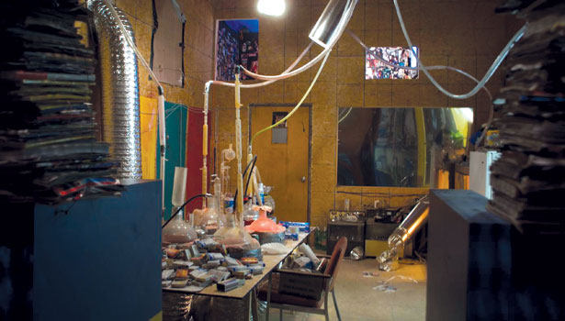
What Is Its Origin?
Meth is a manmade chemical unlike cocaine
Commonly manufactured in illegal hidden laboratories
Combined with other substances such as battery acid
First made in 1887 in Germany
Developed in Spain in 1919
1970 U.S. government made it illegal
1990 Mexican Drug Trafficking organizations set up labs in California

Slide 7
Short-Term Effects Of Meth
Increased energy
Decreased appetite
Breathing more or faster
Rapid or irregular heartbeat
Overheating

Slide 8
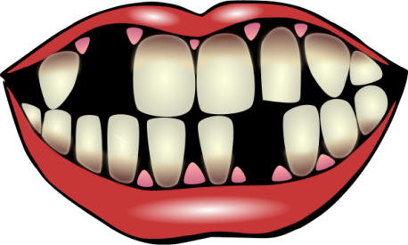
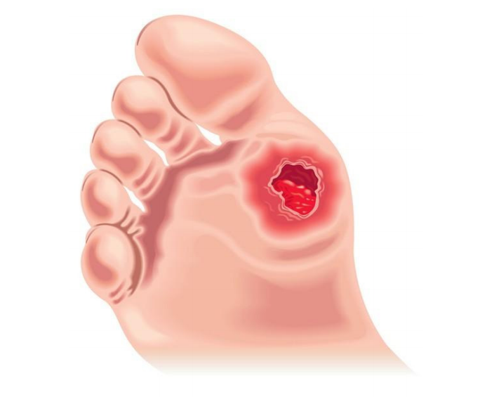
Long-Term Effects Of Meth
Paranoia or hallucinations
Problems in thinking ability
Memory loss
Aggressive or violent behavior
Extreme weight loss
Dental problems
Skin sores
Erratic mood fluctuations

Slide 9
What Are The Legal Consequences If You Get Caught?
Penalties of meth crimes are getting stricter
Possession results in fines anywhere form $1,000 to $500,000
Jail time can range from less than 1 year to over 20 years
Sale and distribution fines can range from $5,000-$1,000,000
Some judges may consider it a felony

Slide 10
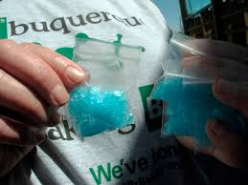
What Is The Cost?
One hit of meth-a quarter of a gram will cost about $25
Can get as high as $80
The price may also depend on the drugs purity, amount, and where it’s sold.

Slide 11
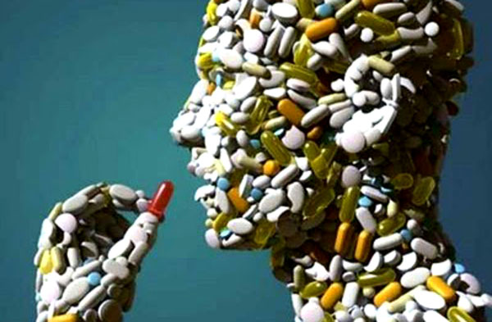
Is Meth Addictive?
Meth is highly addictive
Burns the body’s resources
Creates a dependence that can only be relieved by taking more of the drug
Many users get addicted from the first time they use it

Slide 12
Crimes Associated With Meth
Theft crimes: Users steal to support habit
Assault and battery: Users become more hostile, also physical strength may increase dramatically
Resisting arrest: Users become so strong it may take 4 or 5 officers to handle the person
Gang activity: Crystal meth is often linked to gang activity and violence

Slide 13
THE TRUTH ABOUT METH

Slide 14
Bibliography
www.drugfreeworld.org
www.drugs.com
www.drugefreesport.com
www.drugfacts.com

