Slide 1
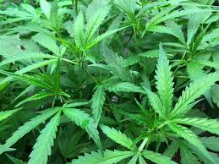
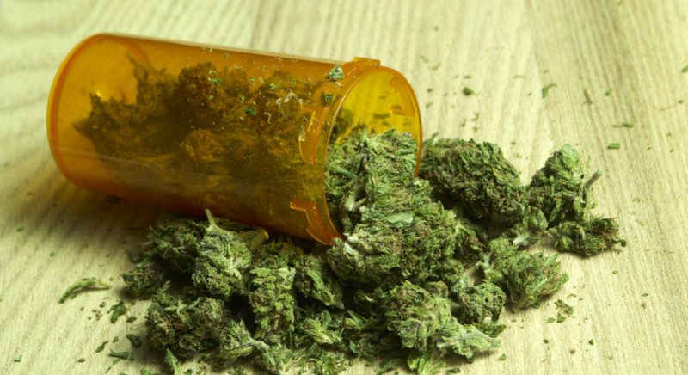
Marijuana
JA’DA BOONE, SARA DAWOOD
MS. McLean
Health-4th hour
December 6, 2016

Slide 2
What are street Names/Slang terms?
Street Names
Slang Terms
Pot
Grass
Joint
Mary Jane
Burn one
Fire it up
Get the wind
Torch up

Slide 3
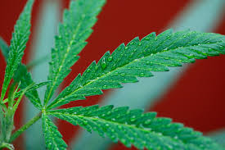
What is Marijuana?
The dried leaves and female flowers of the hemp plant, used in cigarette form as a narcotic
Marijuana, also known as a Cannabis is a drug that is sometimes used
for uses medical uses although it is illegal in half of the states.
It is illegal is 26 states
and legal in 24 states
It gets people high, and there has been reported cases of marijuana as a treatment with many disease such as cancer, pain, muscle spasms.
Hemp- the cannabis plant, especially when grown for its fiber.
Narcotic- a drug or other substance affecting mood or behavior and sold for nonmedical purposes, especially an illegal one.
Cannabis- Cannabis is a genus of flowering plant that includes three species or subspecies, sativa, Indica, and ruderals.

Slide 4
What does marijuana look like?
Marijuana is a leaf that is dark green
Some people it smell like pine or skunk
Marijuana dose not really have a smell
Marijuana come in many different sizes grams, ounces, and pounds

Slide 5
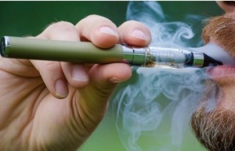
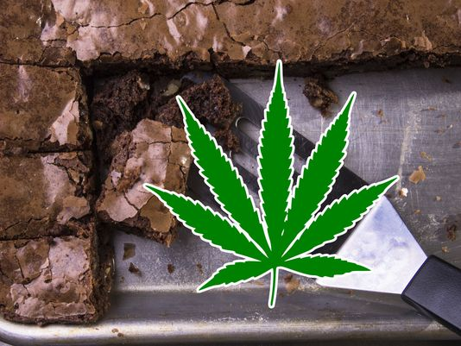
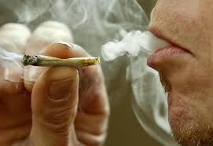
How Is it administered?
It can be smoked as a cigarette(joint), but may also be smoked in a bong
It can be consumed in tea or inedible foods
You can inhale marijuana by vaporizing
Its effects depend on the type of marijuana and the amount of Tetrahydrocannabinol (THC).
The male marijuana has less amounts of THC then the female marijuana.

Slide 6
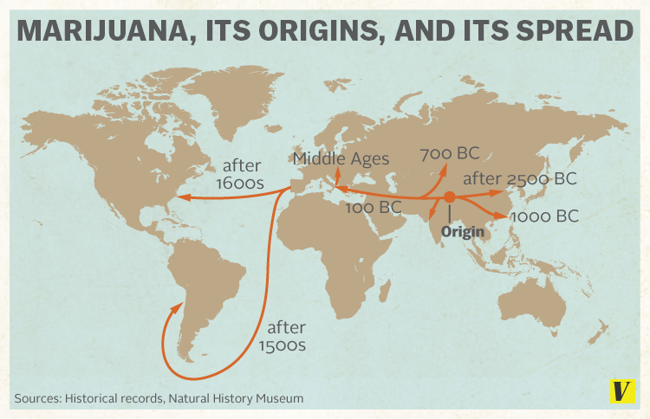
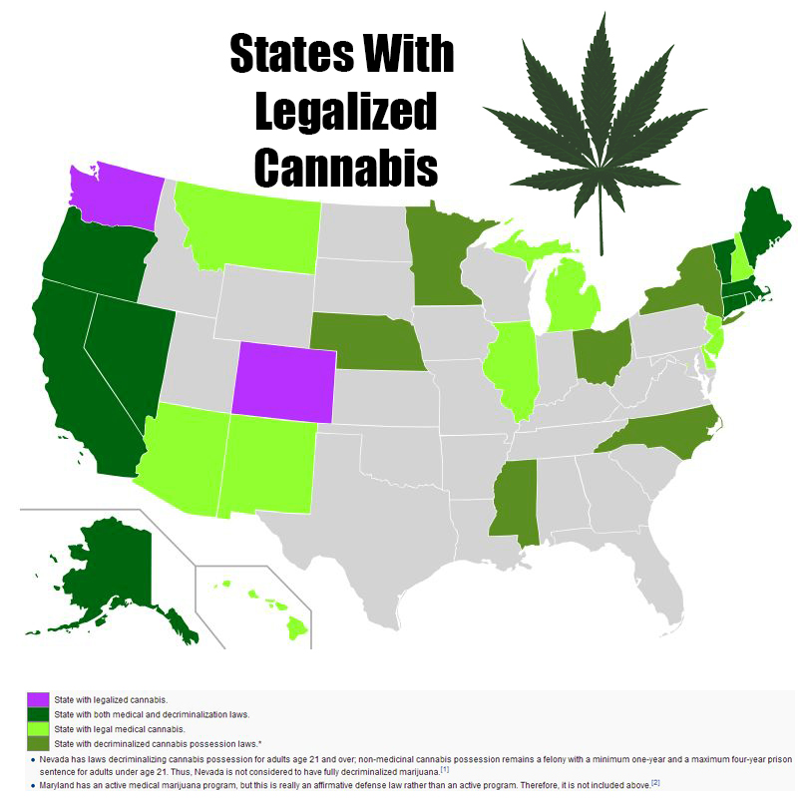
What is it origin?
The oldest known written record on cannabis use comes from the Chinese Emperor Shen Nung in 2727 B.C.
In 1545 cannabis spread to the western hemisphere where Spaniards imported it to Chile for its use as fiber
Marijuana originated from Asia and the first people to use it were the Chinese. The Romans and the Greeks also used marijuana.

Slide 7
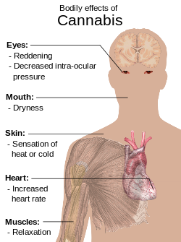
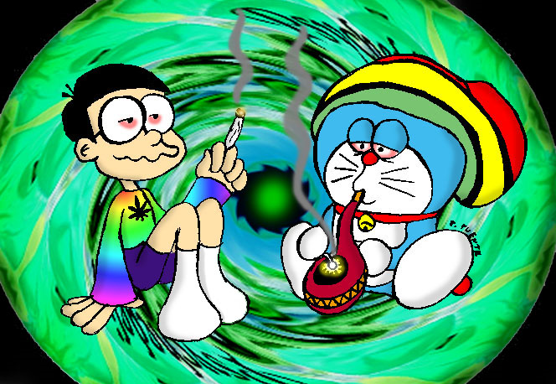
Short term effects
Short-term memory problems
Very strange behavior, seeing, hearing or smelling things that aren’t there
Loss of sense of personal identity
Increased heart rate (risk of heart attack)
Increased risk of stroke
Up to seven times more likely to contract sexually transmitted infections
Poor Coordination of Movement
Lowered Reaction Time
Coordination: the ability to use different parts of the body together smoothly and efficiently

Slide 8
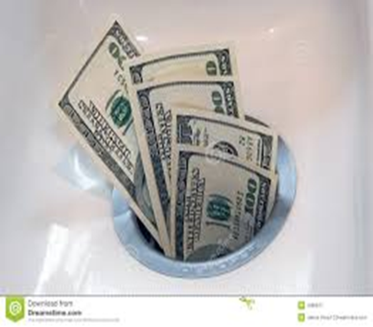
Long term effects
Poor school performance and higher chance of dropping out
Impaired thinking and ability to learn and perform complex tasks
Relationship problems
Antisocial behavior including stealing money or lying
Financial difficulties
Greater chances of being unemployed or not getting good jobs
opiate: used in medicine for inducing sleep and relieving pain
Unemployed: of a person) without a paid job but available to work
mental health disorder characterized by disregard for other people.

Slide 9
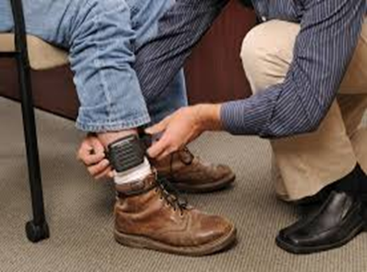
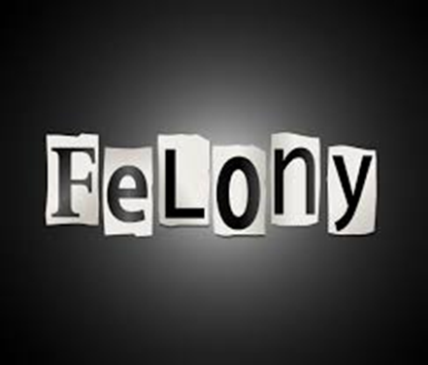
What are the consequences if Caught using/Selling Marijuana?
If you get caught using weed the judge can send you to jail
You also can get fined 2,000 dollars
If you do not get jail time you can get probation
Probation- the release of an offender from detention, subject to a period of good behavior under supervision.

Slide 10
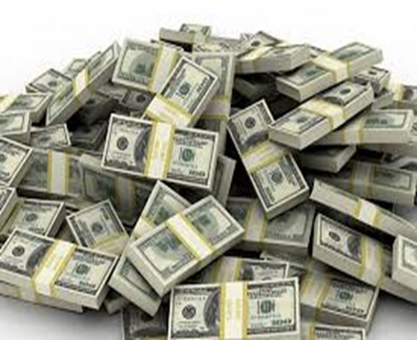
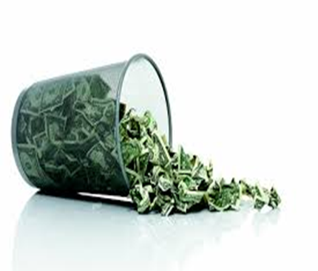
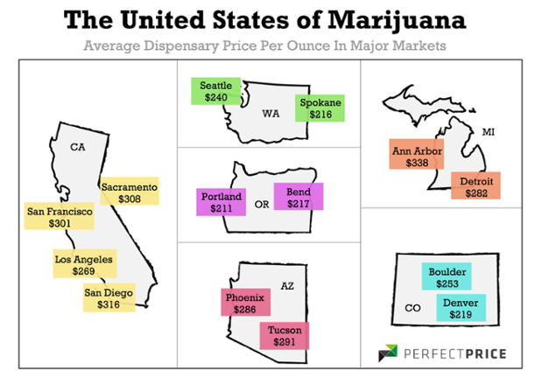
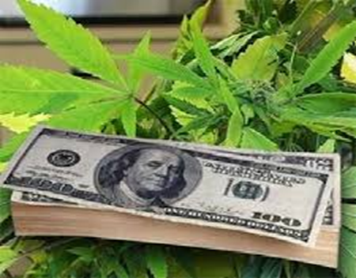
What Is the cost of marijuana?
The cost varies from state after another
In Michigan an ounce cost $301, $15-$25 a gram

Slide 11
Is Marijuana an Addiction?
No it’s not addictive, you will have no withdrawal symptoms by not using it for a time.
Marijuana can be addictive but it happens rarely it doesn’t often happen
withdrawal symptoms: Physical and mental symptoms that occur after stopping or reducing intake of a drug.

Slide 13
Bibliography
http://www.drugfreeworld.org/drugfacts/marijuana/short-and-long-term-effects.html
https://www.drugabuse.gov/publications/drugfacts/marijuana
www2.courtinfo.ca.gov › Teens › Resources › The Substances › Marijuana
www.drugfreeworld.org › THE TRUTH ABOUT MARIJUANA

