Slide 1
major muscles
FITNESS FOR LIFE
MS. MCLEAN

Slide 2
LASTISSMUS DORSI

Slide 3
DELTOIDS

Slide 4
HAMSTRINGS

Slide 5
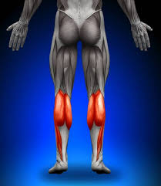
GASTROCNEMIUS

Slide 6
STERNOCLEOMASTOID

Slide 7
TRAPEZIUS

Slide 8
QUADRICEPS

Slide 9
WRIST EXTENSORS

Slide 10
PECTORIALIS

Slide 11
ANTERIOR TIBIALIS

Slide 12
OBLIQUES

Slide 13
ERECTOR SPINAE

Slide 14
TRICEPS

Slide 15
WRIST FLEXORS

Slide 16
RECTUS ABDOMINIS

Slide 17
BICEPS

