Slide 1
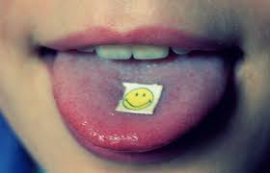
LSD
Hailey Roffe, Tayler Jackson, Sharleen Nona
4th hour
Ms. McLean

Slide 2
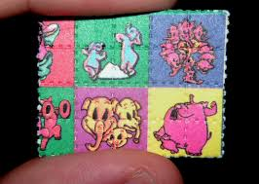
Street Names for LSD
Acid
Tabs
Shrooms
Lucy
California Sunshine
Dots
Zen

Slide 3
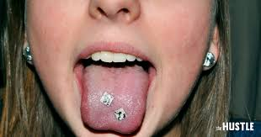
What is Lsd?
LSD is a synthetic crystalline compound, lysergic acid diethylamide, that is a potent hallucinogenic drug.

Slide 4
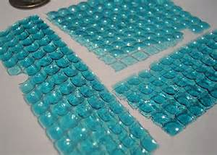
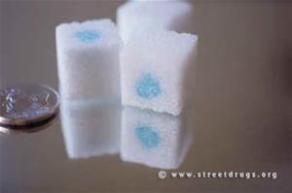
What does it look like?
LSD most often comes in “tabs”, which are bright, colorful pieces of paper that are soaked with the drug.
If the tab tastes like anything but paper, it is bad and you should spit it out.
No smell
Also comes in cubes and gel

Slide 5
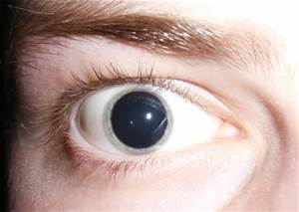
How is it administrated?
Most often it is taken orally.
Gelatin and liquid can be put in the eyes.

Slide 6
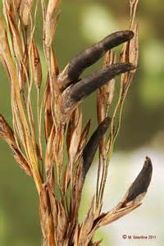
Where did LSD come from? How is it made?
It is manufactured from lysergic acid, which is found in ergot fungus that grows on rye and other grains.
Albert Hofmann, Switzerland, in 1938 created it to help with headaches.

Slide 7
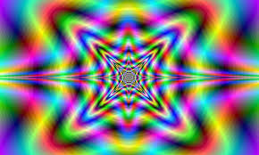
What are the short term effects?
The physical effects include dilated pupils, higher body temp., increased heart rates and blood pressure, sweating, loss of appetite, sleeplessness, dry mouth, and tremors.

Slide 8
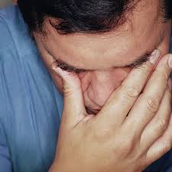
Long term effects?
Some LSD users experience flashbacks, recurrence of certain aspects of a persons experiences even if the user doesn’t take the drug again.
Flashbacks occur without warning, and may occur within a few days or over a year.

Slide 9
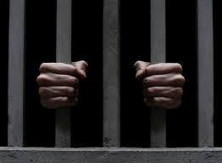
What are the legal consequences if you are caught buying or selling?
If you care caught in possession of or selling 1-9 grams mixture,
First offence
-between 5-40 years in jail
- if death or serious injury, no less than 20 years or more than life
Second offence
-no less than 10 years, no more than life in jail
-If death or serious injury life imprisonment

Slide 10
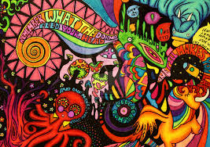
How much is LSD?
Ranges from $10 to $40 ; it depends on the dealer and how much you buy
At wholesale it goes for $3000 per gram, which is enough for 10,000 hits

Slide 11
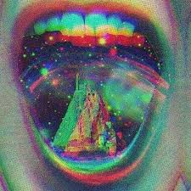
Is it addictive?
LSD is not considered a highly addictive drug
It doesn’t produce the cravings associated with physical addiction
Most people stop using it on their own

Slide 12
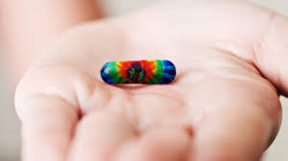
VIDEO
https://www.youtube.com/watch?v=LJbrLSU2Tk4

Slide 13
Bibliography
http://www.dependency.net/learn/lsd/#Is
http://www.drugfreeworld.org/drugfacts/lsd.html
https://answers.yahoo.com/question/index?qid=20070512110408AABkZWb

