Slide 1
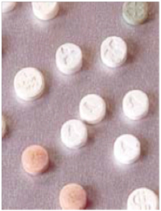
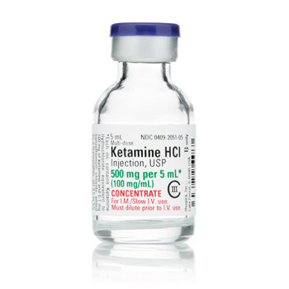
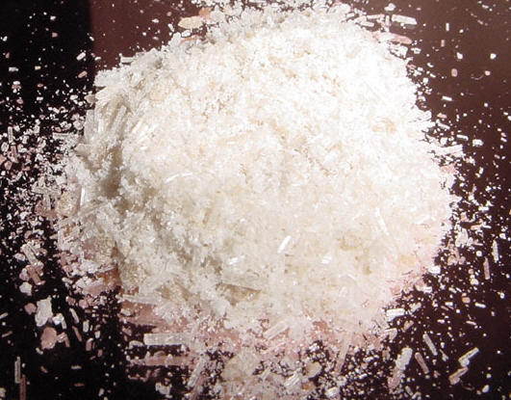
Ketamine
Amanda Rushing & Jessa Francis | Ms.Mclean | Health 4th Hour / December 9,2016

Slide 2
Street names & slang terms
Some terms:
Cat Valium
Cat Tranquilizer
K
Special K
Super K
Vitamin K
Kit Kat
Purple
Jet
Terms for the high after taking the drug:
K-hole
K-land
Baby Food
God

Slide 3
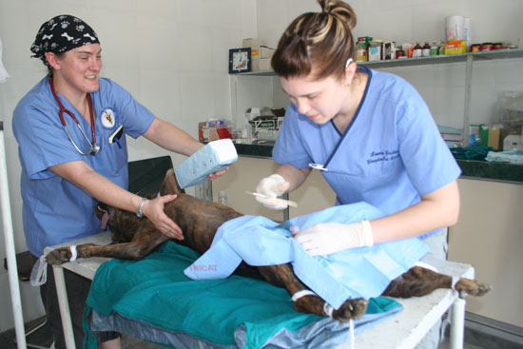
What is it?
Ketamine is a type of anesthetic, usually used in animals.
Small dosage can kill humans because it is meant to put animals to sleep, and is very strong.

Slide 4
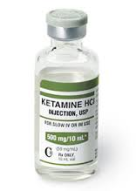
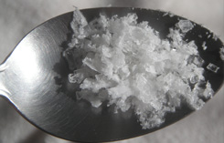
What does it look like?
Ketamine is white
Ketamine is usually used in a liquid form, and there is a certain dosage. Each dosage depends on body weight.
It has a salty taste to it, and can burn if snorted.
Pure ketamine usually doesn’t have a smell but if mixed, laced, or not pure is can smell like a vitamin pill
Notes:
Summarize your research in three to five points.

Slide 5
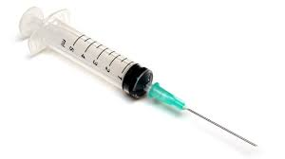
How is it administered? how long is the effect and how long does it last?
How its administered
How long will it take to effect you
How long it lasts
Snorting-taking it through the nose
Snorting- 5-10 minutes to take into effect
Snorting- 20mins to an hour
Injected- using an needle into a vein
Dabbing- using finger after applying water or putting it in food or drinks
Bombing-placed into a small portion of cigarette paper, shaped like that a ball that is swallowed
Injected- very quickly; within minutes. Very powerful
Dabbing- quickly
Bombing- about an hour
Injected- it ends very quickly
Dabbing- depend on how much is taken
Bombing-about 4 hours

Slide 6
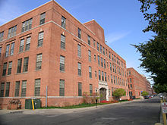
Where did it come from? How is it made? who made it? What is it used for, originally?
Where it came from? Who made it?
How is it made?
Its original use
It was first found in 1962
Its made of:
The original use for it was to put animals to sleep during important surgeries.
Scientist Calvin Stevens founded the drug
Founded at Parke Davis Laboratories
dl 2-(0-chlorophenyl)-2-(methylamino) cyclohexanone hydrochloride.

Slide 7
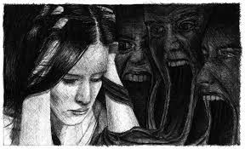
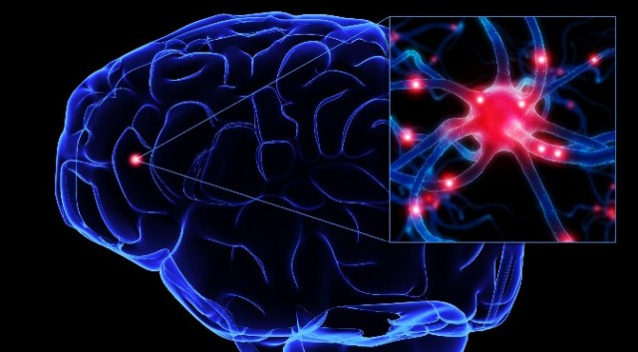
Effects
Short term
Long term
Nausea
Vomiting
Euphoria-a feeling of excitement and happiness that is intense
Sporadic eye movements
Delirium
Blunted affect or lack of emotional expression
Hallucinations
Decreased bladder volume
Blood in urine
Kidney problems
Brain damage
Notes:
Establish hypothesis before you begin the experiment. This should be your best educated guess based on your research.

Slide 8
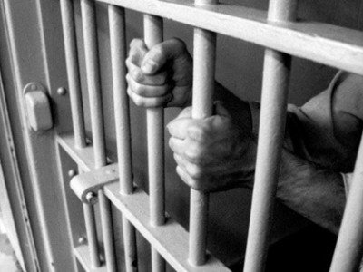
Legal actions if caught taking or selling:
In order to have ketamine you have to have a license or a prescription
Being arrested and sentenced to five years
Or being fined $250,000

Slide 9
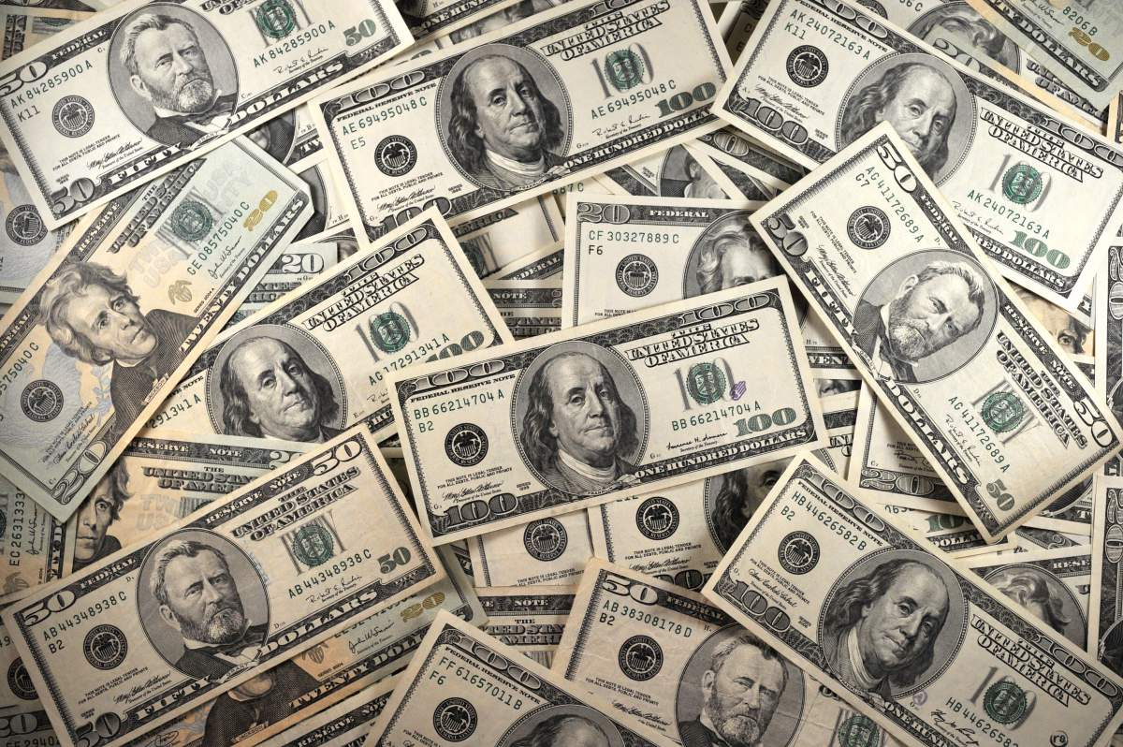
The cost of ketamine
20-50$ if sold through friends, family, or for larger purchases
At parties its about $50-150 per gram

Slide 10
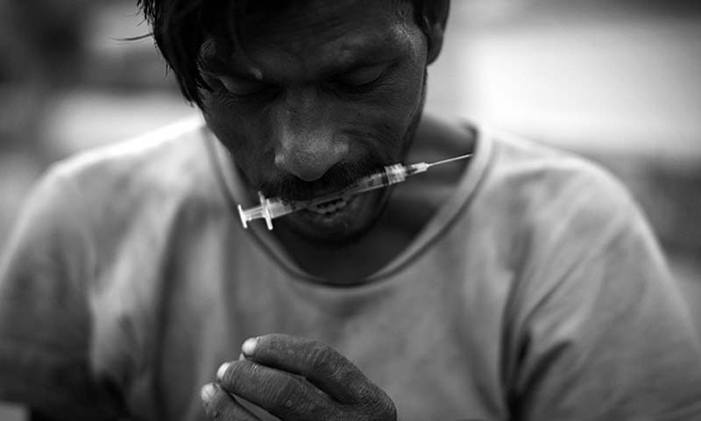
Is it addictive?
Ketamine is a very addictive drug. After a few times of taking this drug the user begins to crave it. Users describe the feeling as being away from their bodies. They enjoy the feeling of not really existing, which is why they crave it.

Slide 11
Video =)
http://channel.nationalgeographic.com/drugs-inc/videos/the-k-hole/

Slide 12
bibliography
National geography.com
Ketamine.com
Drugabuse.com

