Slide 1
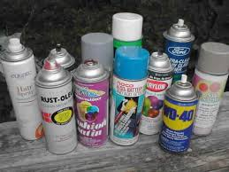
INHALANTS
MALAYA DENNIS
MS.MCLEAN
HEALTH-4TH HOUR
12/7

Slide 2
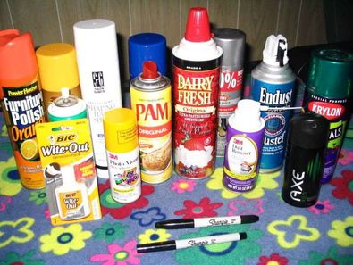
STREET NAMES
Air blast –term for inhalants
Bagging –using inhalants
Bang- injecting inhalants
Bullet bolt –term for inhalants
Highball – term for inhalants
Huffing – to sniff inhalant
Glading – to use inhalant

Slide 3
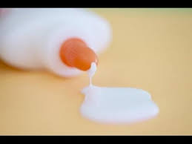
What is it?
INHALANTS ARE MOSTLY EVERYDAY ITEMS THAT WE USE.
INCLUDING:
GLUE
PAINT
GASOLINE
LIGHTER FLUID

Slide 4
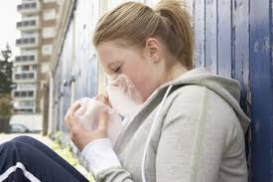
HOW IS IT USED?
Abusers of inhalants breathe them in through the nose or mouth in a variety of ways known as “huffing”. They may sniff or snort fumes from a container or dispenser , spray aerosols directly into their nose or mouth, or place a chemical-soaked rag in their mouth. Abusers may also inhale fumes from a balloon or a plastic or paper bag. Although the high produced by inhalants usually lasts just a few minutes, abusers often try to prolong it by continuing to inhale repeatedly over several hours.

Slide 5
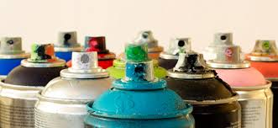
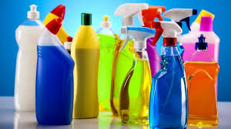
WHAT DOES IT LOOK LIKE?
Inhalants include chemicals found in such household products as aerosol sprays, cleaning fluids, glue, paint, paint thinner, nail polish remover, and lighter fuel. They are sniffed or “huffed”

Slide 6
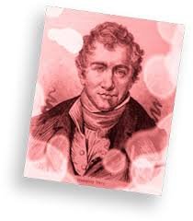
ORIGIN
Use of these substances began in ancient times, when people inhaled spices, oils and chemical vapors to alter mental states, but the first notable use of inhalants in the US began in the 1800s, when groups of people began using nitrous oxide for recreational use.
The intoxicating effects were as pleasant as those of alcohol, but users discovered that inhalants seemed to have safer effects (in fact, scientists discovered that nitrous oxide can numb pain during surgery, so they now use it as an anesthetic). People continued to abuse inhalants for euphoric highs into the twentieth century, so many people in the 1940s inhaled household items to get high. By the 1950s, inhalant use became widespread, particularly the use of gasoline

Slide 7
SHORT TERM EFFECTS
SLURRED SPEECH
Drunk, dizzy or dazed appearance
Inability to coordinate movement
Hallucinations and delusions
Hostility
Apathy

Slide 8
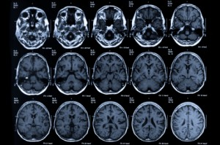
Long term effects
Muscle weakness
Disorientation
Lack of coordination
Irritability
Depression
Serious and sometimes irreversible damage to the heart, liver, kidneys, lungs and brain
Memory impairment, diminished intelligence
Hearing loss
Bone marrow damage
Deaths from heart failure or asphyxiation (loss of oxygen)

Slide 9
LEGAL CONSEQUENCES
Although inhalants are not regulated under the Controlled Substances Act, thirty-eight states in the US have placed restrictions on the sale and distribution to minors of certain products that are commonly abused as inhalants. Some states have introduced fines, incarceration or mandatory treatment for the sale, distribution, use and/or possession of inhalant chemicals.

Slide 10
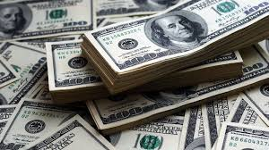
COST
The monetary cost for inhalants may seem insignificant at first in comparison to other drugs, but this addiction can really add up. With more and more product being purchased regularly to supplement the addiction, a serious inhalant user can end up with an expensive chemical shopping list. Some states in the U.S. have made inhalant abuse illegal and being caught using may lead to jail time or fees.

Slide 11
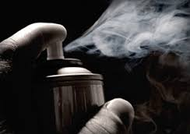
ADDICTIVE
Inhalants are addictive

Slide 12
bibliography
https://www.addictionhope.com/inhalants/
http://www.inhalantaddictiontreatment.com/
http://www.drugfreeworld.org/
https://www.drugabuse.gov

