Slide 1
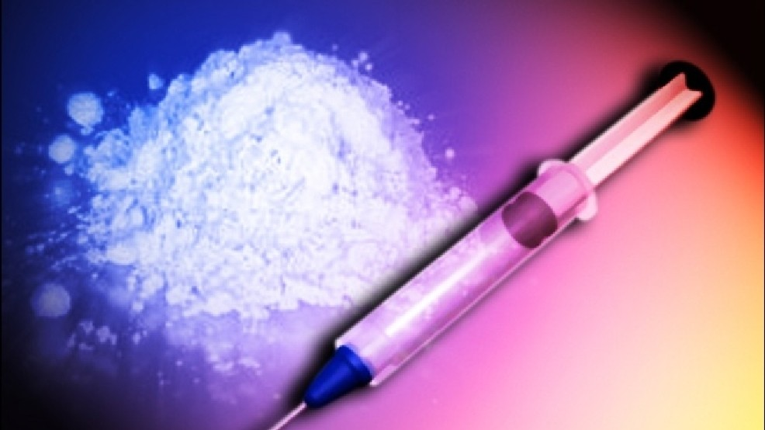
Heroine
By Manhal Zaya, Brandon Rice and Nadbiha Jacob
Ms.McLean
Health-4th Hour
May 25,2016

Slide 2
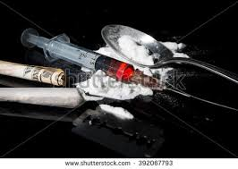
Street Names
Black tar
Skag
Smack
White stuff
Mexican horse
Chiva
Brown sugar
Pluto
Mud
dope

Slide 3
What is Heroin?
Heroin is a drug that is synthesized from morphine, which is a naturally occurring substance that comes from the seed pod of the Asian opium poppy plant.

Slide 4
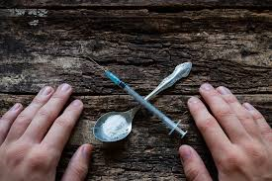
What does it look like?
Size- It weighs in gram ounces since it’s a powder and it doesn’t have a specific size.
Color- It can be either, brown, white, or black.
Taste- You can smoke it or inject it into yourself so that’s why it doesn’t have an exact taste.
Smell- It tastes exactly like a regular cigarette would smell like.

Slide 5
How is Heroin administrated?
Heroin can be administered orally, smoked, inhaled, or injected.
You get the effect straight away. Heroin lasts for about a few hours peeking for about 2 hours after administration.

Slide 6
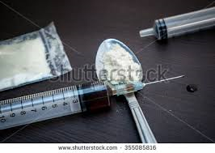
Short term effects for Heroin
Nausea
Vomiting
Dry mouth
Severe itching
Slower heartbeat
Slow breathing

Slide 7
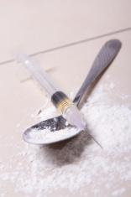
Long term effects for Heroin
Bad Teeth
Coma
Respiratory Illnesses
Depression
Weak immune system
Insomnia

Slide 8
What are the legal consequences?
Heroin is a federal offence and can be sentenced to not more than a year in prison.
Fines not less than a $1000 or even both.
States will also punish the possession of heroin, and the sentence will vary according to state law.

Slide 9
What is the cost of Heroin?
Heroin can cost anywhere from $10 to a $100.

Slide 10
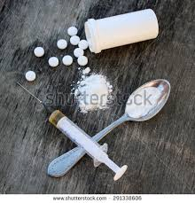
Is Heroin addictive
Yes, heroin is extremely addictive because once you become an addict, you will need a certain amount of does at certain times

Slide 11
The truth about heroin
https://youtu.be/KxGL2bZyDbk

Slide 12
Bibliography
Drugabuse.Gov
Novusdetox.com
YouTube
Drugfreeworld.org

