Slide 1
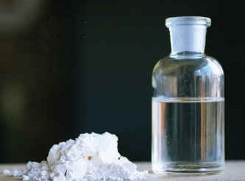
GHB Gamma Hydroxyboutyrate
Meriam Jammoa
Rossela Mikho
Issa Habeeb
Ms. McLean- Health
4th Hour
May 23, 2016

Slide 2
What are the street names?
Georgia Home Boy (GHB)
Liquid X and Liquid E
Liquid Ecstasy
G
Vita-G
G-Juice
Bedtime Scoop
Soap
Gook
Gamma 10
Energy Drink
Grievous Bodily Harm (GBH)

Slide 3
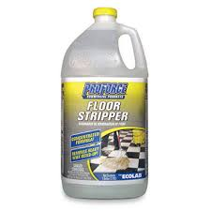
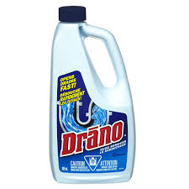
What is it?
GHB is a drug that is synthetically made from Gamma Butyrolactone or GBL, Sodium Hydroxide, and Potassium Hydroxide.
To put it in more basic terms, GHB is a degreasing solvent or floor stripper mixed with drain cleaner.
Here is a short history of GHB
1960s: First suited for sleep disorders
1970s: Used to treat narcolepsy
1990-93:Recreational use increased; FDA declares it “unsafe and illicit”
1999:DEA recommended it for scheduling
2000: Federally controlled schedule 1 drug (drugs that have no currently accepted medical use and a high potential for abuse)
+

Slide 4
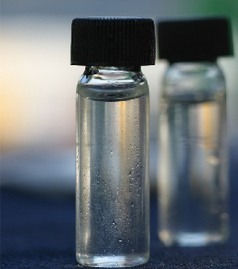
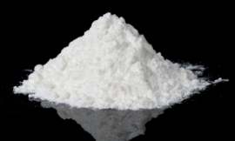
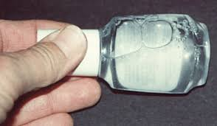
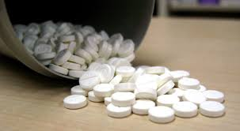
What does it look like?
GHB Can Look Like…
A clear odorless liquid
A pill or capsule
A white crystalline powder

Slide 5
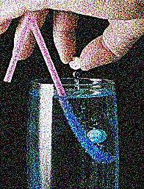
How is it administered?
It is often diluted into other drinks
Can be taken orally by taking pills and capsules
GHB can be snuffed when in powder form
In extreme cases of addiction, many people administer it through an IV-Tube

Slide 6
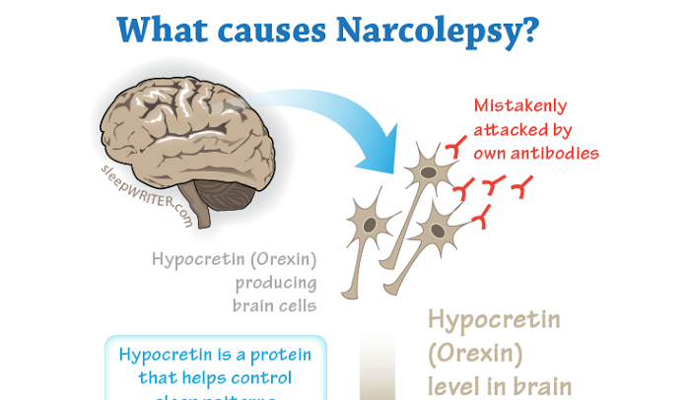
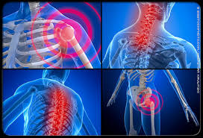
what is its origin?
GHB is a man-made synthetic drug, that was discovered as a naturally occurring chemical in the human brain.
It was introduced into medicine in 1960 and 1963 and was originally intended to treat narcolepsy and fibromyalgia.
Fibromyalgia

Slide 7
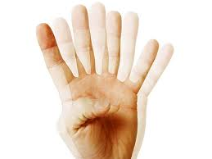
what are short term effects?
Amnesia
Euphoria
Lack of inhibitions
Nausea
Dizziness
Agitation
Blurred Vision
Unconsciousness
Slowed Breathing

Slide 8
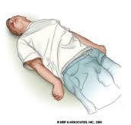
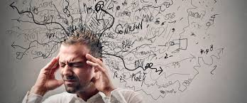
What are THE long term effects?
Difficulty Concentrating
Hallucinations
Slurred Speech
Headaches
Amnesia
Respiratory depression
Mouth sores and infections
Cardiovascular collapse
Muscle pain
Extreme anxiety
Seizures

Slide 9
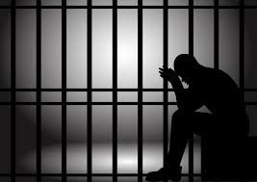
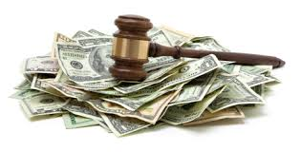
What are the legal consequences if caught using and or selling this drug?
The penalties for distributing, selling or manufacturing GHB is a crime of a seconds degree. The offense carries a fine of up to $150,000 and a prison sentence of 5 to 10 years.
An individual possession of GHB is a crime of the third degree and can leave you with a fine of $100,000 and can carry a prison sentence of 0 to 5 years.

Slide 10
What is the cost?
One teaspoon of GHB can cost anywhere from $5 to $10 per dose.

Slide 11
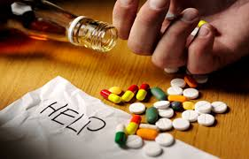
Is it addictive?
Yes, It is an addictive drug. Withdrawal can be severe and prolonged.
GHB addiction is characterized by around the clock dosing (every one to three hours, day/night, with heavier doses at night to achieve sleep.)
Addiction can develop in a few weeks.

Slide 12
Quick Reviiew

Slide 13
Bibliography
http://www.hazelden.org/web/go/info_ghb
http://www.projectghb.org/
https://www.youtube.com/watch?v=brPf7X-Gmy8

