Slide 1
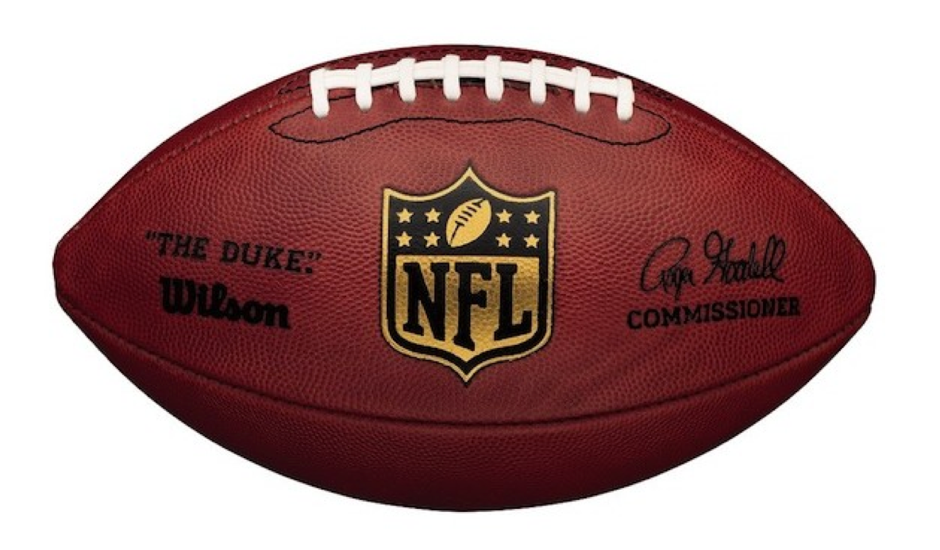
Football

Slide 2
History
America’s favorite fall sport. The game is played mostly in the United States.
Football is a descended of soccer. Turned into a the game of Rugby in 1823. When one player picked up the ball and ran with it and the other players tried to get the ball back by tackling him.
1871 in the USA, the group of Harvard athletes started to put teams together to play rugby/football style games.
A Yale player/coach started to establish a few rules for the game in the USA. From here the game develop and rules have been tweaked ever since.

Slide 3
Objective
Is for one team to move the football across the opposition’s goal line. Therefore scoring. The team with the most points at end of the game wins.

Slide 4
Scoring
https://youtu.be/3HKajcfNIi0
Touchdown (6 pts): carrying or passing the ball across the opposition goal line.
Field Goal (3 pts): kicking the ball over the crossbar and through the goal posts.
Safety (2 pts): forcing the other team to down the ball behind its own goal line.
Extra Point (1 pt): allowed after scoring a touchdown. Kicked through goal posts. The ball is placed on 2 yd line for pro’s. 3 yd line for college and high school.
Conversion (2 pts): extra point that is ran or passed over the goal line.

Slide 5
Goal Post
Upright
23’ wide
High School
Upright
18 ½’ wide
Pro
Crossbar
Post (10’)

Slide 6
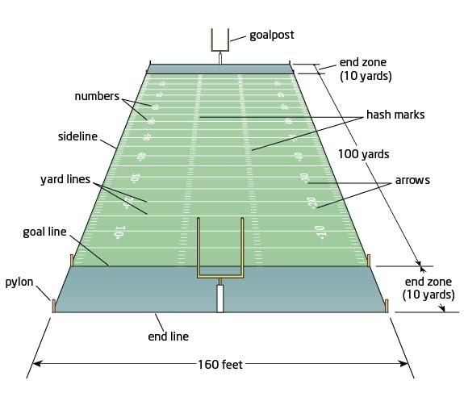
. Pro’s 70' from sideline. H.S./College 53' 4" from sideline
Midfield Line
50 yard line
Every 5 yards
120 yards long and 53 1/3 yards wide. Natural grass or Astro Turf.

Slide 7
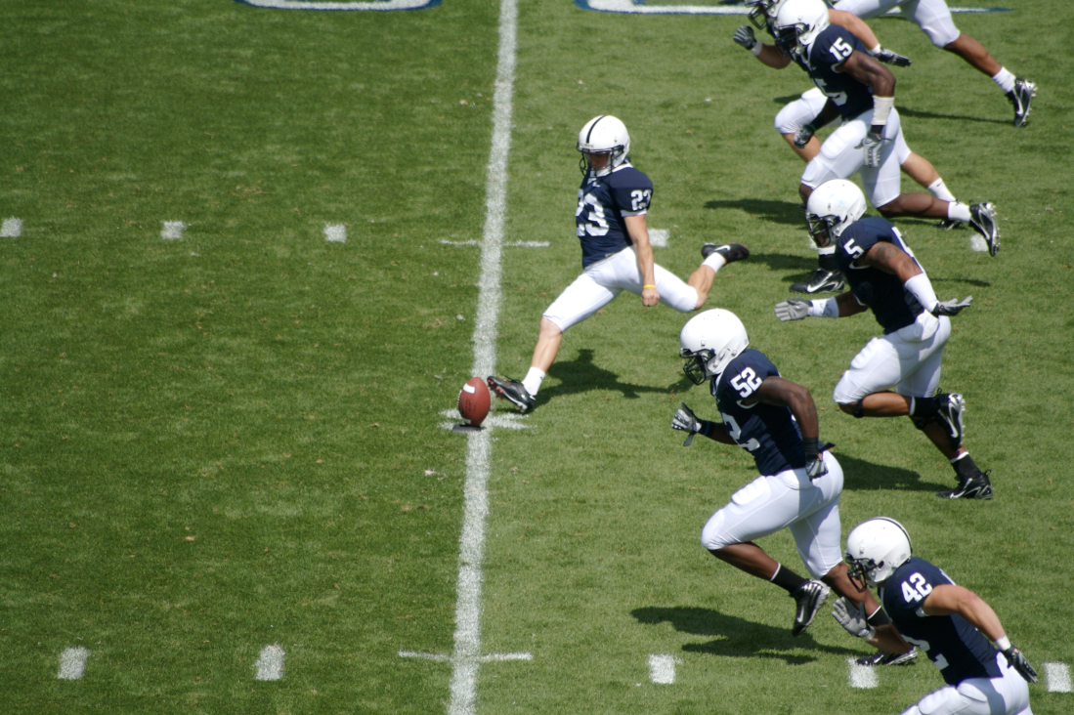
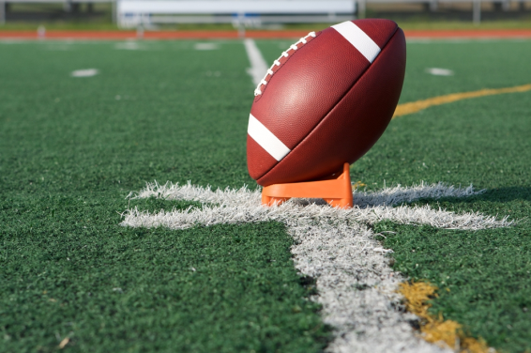
Kickoff
Starts each half of a football game.
Pro kicker kicks from 35 yd line. H.S./College from 40 yd line.
A coin toss determine who receives, kicks, and which end your team is on.
After the ball travels 10 yds. It become a free-ball (anyone may recover it ).
The team must remain behind the line of scrimmage until the ball is kicked.
Kicker signs the referee by raising his arm.

Slide 8
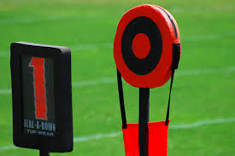
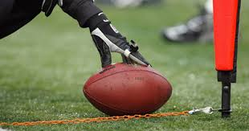
Downs
Downs: The offensive team has four plays, called downs, to move the ball at least 10 yards. When the offense gain 10 or more yards, it earns another first down. The team then gets four more downs to gain 10 more yards.

Slide 9
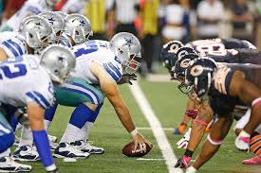
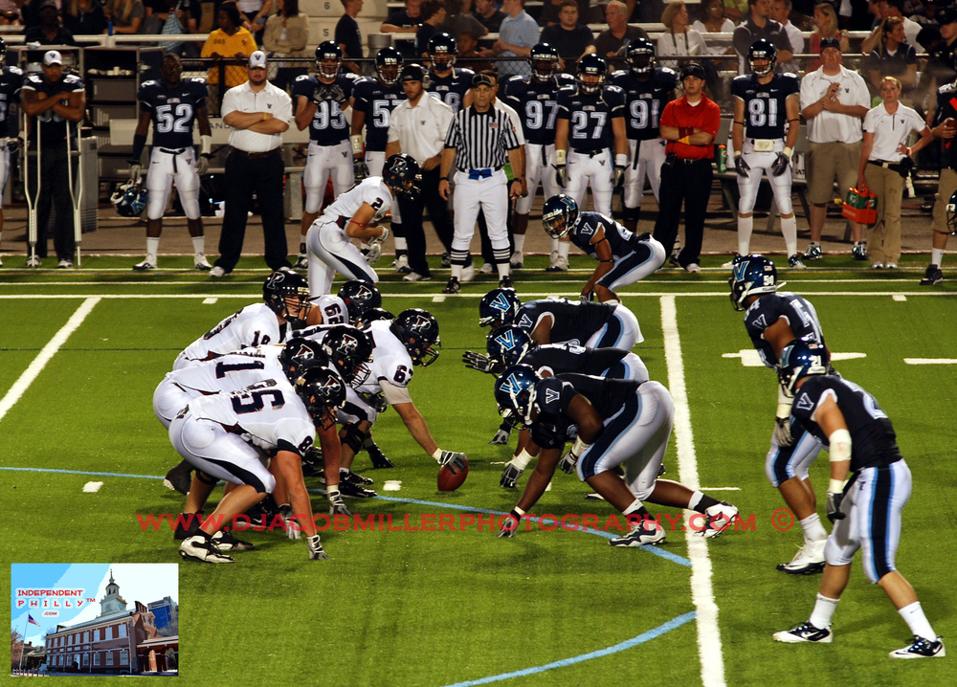
Line of Scrimmage
Line of Scrimmage: two imaginary lines, each of which passes through the tip of the ball and runs parallel to the goal lines. Area between the two lines of scrimmage (length of the ball) is called the neutral zone. No player other than the center can have any body part inside the neutral zone before the ball is snapped, this is considered off-sides.

Slide 10
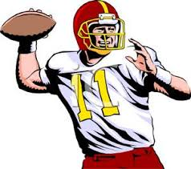
Throwing the Ball
Passing: Must throw the ball from behind the line of scrimmage. Only the ends and running backs are allowed to catch the pass.
Interception: When a defensive player catches a pass. The offensive team loses possession.
Incomplete: a forward pass not caught or intercepted.
Lateral- a pass thrown in any direction except toward the opposition’s goal line.
Pass Rush: the attempt by the defensive team to tackle the quarterback before he throws the ball. If successfully executed is a quarterback sack.

Slide 11
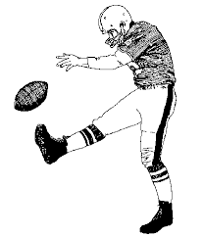
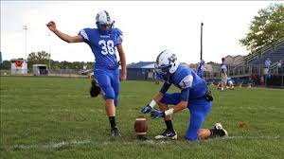
Kicking
Punt: usually on four down the team in possession of ball does not want to take the risk of trying for a first down. The punter sends the ball far downfield. Punter holds the ball in front of him and drops it and kick it.
Place Kick: put ball into play at the beginning of a half or after a touchdown or field goal, or attempting a field goal or extra point. The ball must be in contact with the ground or supported by a tee when kicked.

Slide 12
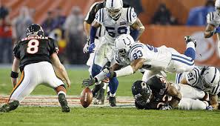
Running the Ball
Fumble: occurs when the ball carrier drops the ball. The team that recovers the ball has possession.

Slide 13
Game Time
60 minutes pros and college, 48 minutes High School.
Half Time: Intermission between halves called half-time, 15 minutes.
Quarters: four. 2 minutes between quarters.
Offensive team has 30 seconds to begin play(snap the ball) after the official places the ball on the hash mark. 25 seconds in H.S./College.
Delay of Game: failure to put the ball in play within the time specified. (5 yards)
Stop the clock
. The ball carrier goes out of bounds
. A forward pass is incomplete
. A player is injured
. A score is made
. A penalty is called
. A timeout is called

Slide 14
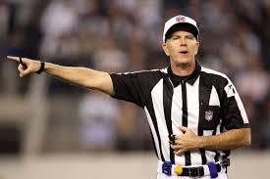
Penalties
Offside: called when a player crosses the line of scrimmage before the ball is snapped. (5 yards)
Holding: when an offensive player uses his hands or arms to ward off a defensive player. (10 yards)
Holding: when a defensive player holds or tackles anyone but the ball carrier. (5 yards) In Pro’s automatic first down.
Clipping: offensive player blocks a defensive player from behind. (15 yards)
Roughing the Passer: defensive player runs into or tackles the passer after the ball has been thrown. (15 yards)
Roughing the Kicker: defensive player who runs into or knocks down the kicker while punting or place-kicking. (15 yards)
Delay of Game: failure to put the ball in play within the time specified. (5 yards)

