Slide 1
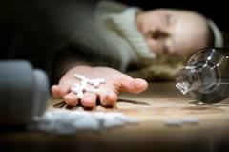
Ecstasy
Maryam Toma Ms. McLean
Alexis Kama May 23, 2016
Jasmine Brining 4th Hour Health

Slide 2
What are the street names/slang terms for it?
MDMA
Molly
Happy Pill
Love Pill

Slide 3
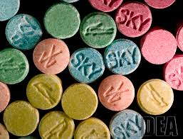
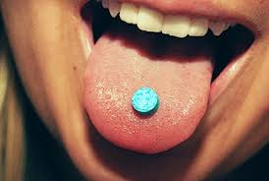
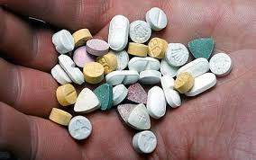
What is it?
A powerful psychoactive drug that produces feelings of heightened energy euphoria, and sensitivity to touch.

Slide 4
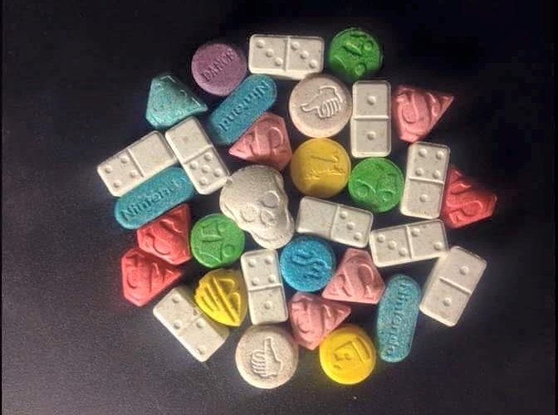
What does it look like? (size, color, taste, smell)
Ecstasy generally comes in tablets of various shapes and colors, often with various designs stamped on them
Bitter, has a synthetic taste
Ecstasy itself is odorless, but sometimes can smell like licorice

Slide 5
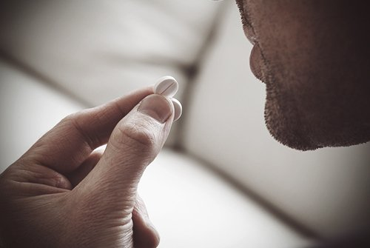
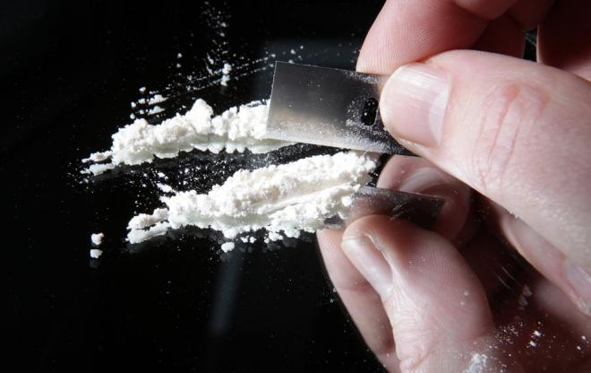
How is it administered?
Ecstasy is mainly swallowed, but may sometimes be snorted, smoked, or injected.

Slide 6
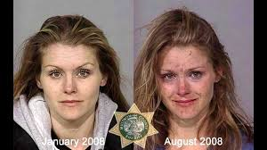
How quick will it take effect and how long does it last?
The amount of time you will feel the ecstasy effects is highly dependent on the amount or dose taken.

Slide 7
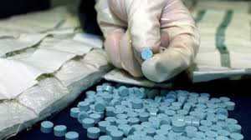
What is it origin (where did it come from? How was it made?)
MDMA was first synthesized in clandestine Labratories in Netherlands and Belgium

Slide 8
What are the short term effects?
Impaired judgment
Muscle tension
Depression
Blurred vision
Confusion

Slide 9
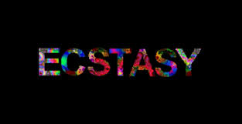
What are the long term effects?
brain damage
Kidney failure
Depression, anxiety, memory loss
Death

Slide 10
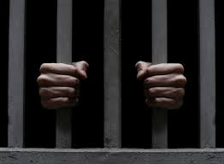
What are the legal consequences if caught using and/or selling this drug?
Possession
Trafficking
Exporting of ecstasy
Could spend 12 years in prison.

Slide 11
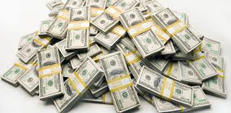
What is the cost?
In the United States the price for a pill is $35.50

Slide 12
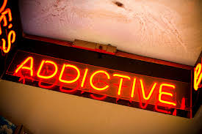
Is it addictive?
Yes it is addictive

Slide 13
https://www.youtube.com/watch?v=jEAr7ThsYew

Slide 14
Bibliography
https://www.sciencedaily.com/releases/2016/04/160418095916.htm
http://www.drugfreeworld.org/drugfacts/ecstasy/short-long-term-effects.html\
http://www.narconon.org/drug-information/ecstasy-x-effects.html
http://www.drug.addictionblog.org/how-long-does-ecstasy-last/
http://www.drugfreeworld.org/drugfacts/ecstasy/imaginary-love-pill.html
http://www.toxquebec.com/livre_drogues/en/index_ecstasy.html
http://www.denverda.org/prosecution_units/drug_court/ecstasy_legal_consequences.htm
http://drugfreeworld.org/drugfacts/ecstasy/short-long-term-effects.html

