Slide 1
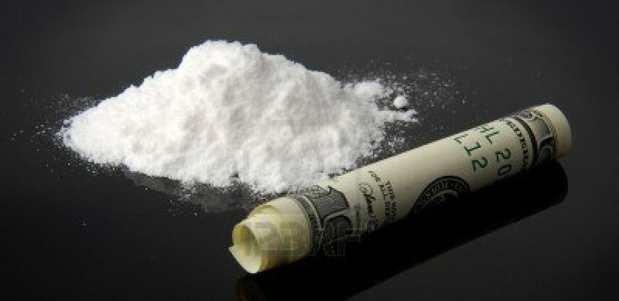
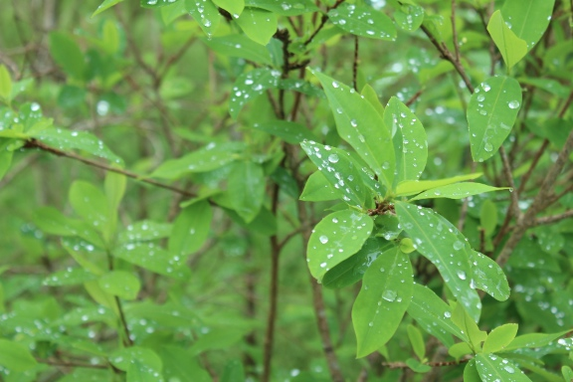
Cocaine
Luke owczarzak, yousif Nadhim, Oshana Dawood
Ms. . Mclean 4th hour
December 8, 2016

Slide 2
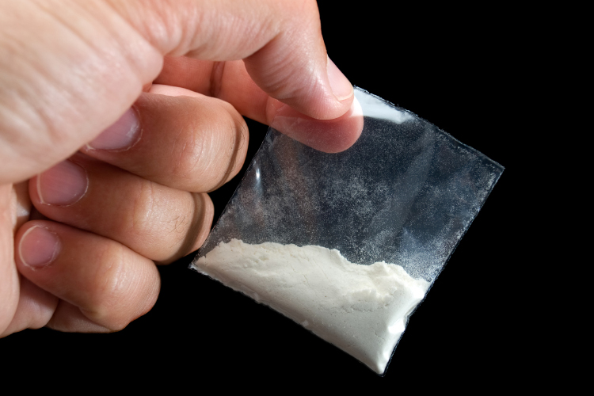
Street names for cocaine
1 blow
2 coke
3 chalk
4Gold dust

Slide 3
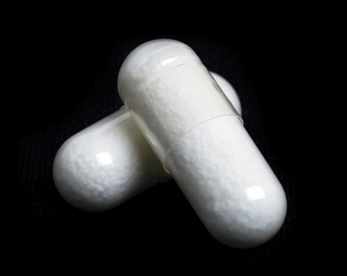
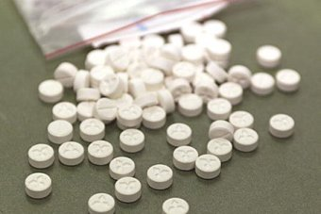
What is cocaine
Cocaine is a level two drug that is a simulant drug it could be used in surgeries and some medication. But is illegal because the effects it causes when abused

Slide 4
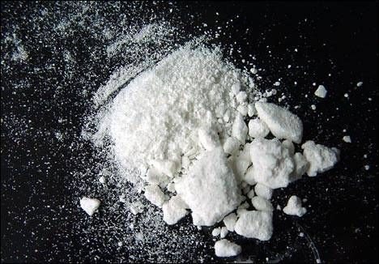
What does cocaine look like
Cocaine is either yellow or white and is either a fine white powder or a powder and clumpy. Cocaine has no smell and has a bitter taste cocaine has many ways of making it because so many people add there own chemicals in it to increase it purity like baking soda and drain cleaner for example
Cocaine is weighed in pounds ounces grams and kilos

Slide 5
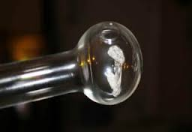
How is cocaine ad mistered
Cocaine is administer by either snorting eating injecting and smoking it cocaine takes about 5 or less minutes to effect your brain and body

Slide 6
Where is originated from
Cocaine was founded in 1532 by Spanish soldiers in Peru it wasn’t till 1859 when German chemist Albert Niemann started to use in in the medical field after that a Austrian psychoanalyst named Sigmund fraud who used him self started to promote it as a cure for depression and loss of sexual dive then in 1884 the newest drink at the time coca cola had small amounts of cocaine and it made the company rich because people couldn’t get enough of it
Cocaine can now be found all over but mostly in the south American countries

Slide 7
What are the short term effects of cocaine
extreme happiness and energy
mental alertness
hypersensitivity to sight, sound, and touch
irritability
paranoia—extreme and unreasonable distrust of others

Slide 8
Other health effects of cocaine
constricted blood vessels
dilated pupils
nausea
raised body temperature and blood pressure
faster heartbeat
tremors and muscle twitches
restlessness

Slide 9
Long term effects of cocaine
loss of smell
Bloody nose
Problems with swallowing
Death
Hiv hepatitis c

Slide 10
Legal consequences of selling or possession of cocaine
First offences for intent to sell or possession could get u probation and possible drug rehabilitation
Felony charge Under 50 g Up to 4 yrs and/or $25,000 50-450 g. up to 20 yrs. and $250,000; 450 g - 1 kg.: up to 30 yrs. and $500,000; Over 1 kg life imprisonment and up to $1,000,000; sale to a minor or near school property wich means they would double the penalties

Slide 11
What is the street cost of cocaine
Detroit $26,000 - $33,500
Grand Rapids $27,500 - $34,500
Saginaw $32,000 - $38,500
$300 to $8 per gram

Slide 12
IS COCAINE ADICTIVE
Cocaine is highly addictive once u administer cocaine u want more witch could cause some serious problems for you and if you choose to have kids your kids could have severe birth defects

