Slide 1
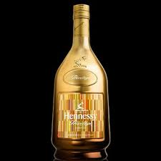
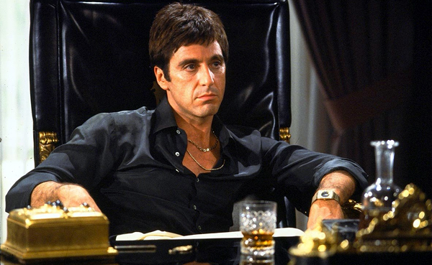
Alcohol
Vasel Ljuljgjuraj, Ali Joudatt, Danny Deljosevic
Health
Ms.McLean 4th Hour
May 24, 2016

Slide 2
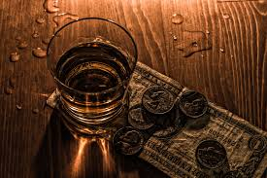
Street name
There are many street names for alcohol such as
Booze
Cold one
Hard stuff
Sauce
Hooch
Moonshine
Draft
Tummy buster
Liquid courage
Redneck wine
brew

Slide 3
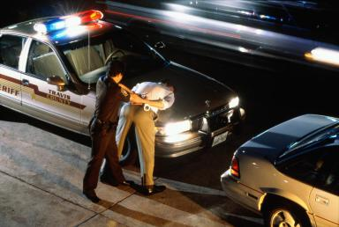
Legal Consequences
These are the consequences if you are caught drunk driving
A criminal record
Jail time.
Getting your driver's license restricted, suspended, or taken away.
Having your car taken away by the state.
Increased car insurance rates.
Paying a fine ($1,000-$18,000)

Slide 4
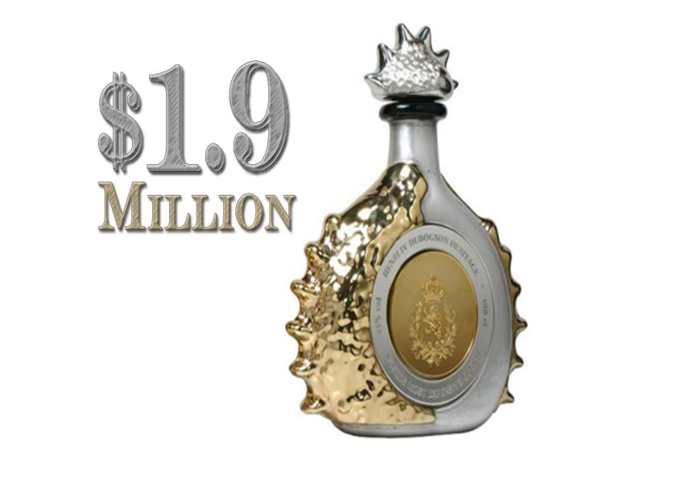
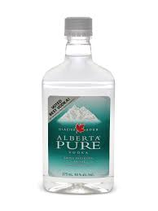
Cost
The price of alcohol can range any where from $7.00-$1.9m

Slide 5
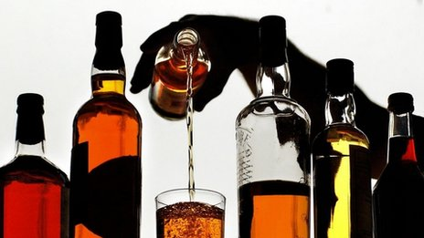
Alcohol
Ethanol, is an intoxicating ingredient found in beer, wine, and liquor.
As for how it affects the mind, it is best understood as a drug that reduces a person’s ability to think rationally and distorts his or her judgment.

Slide 6
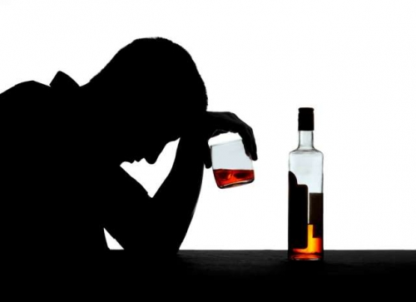
Affects
Alcohol interferes with the brain’s communication pathways, and can affect the way the brain looks and works. These disruptions can change mood and behavior, and make it harder to think clearly and move with coordination.

Slide 7
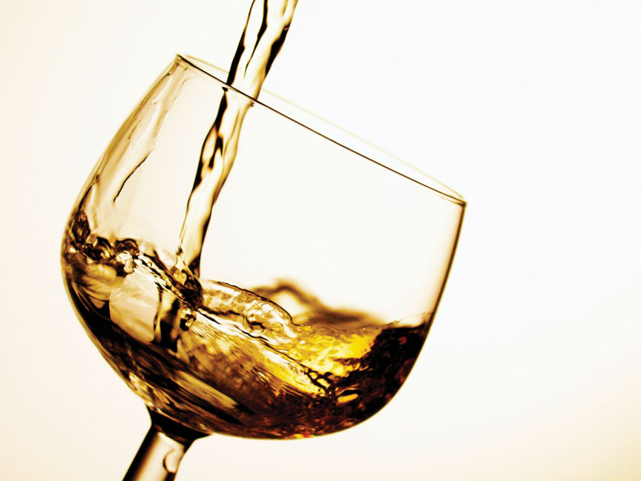
Youtube
https://youtu.be/IYqsWAjvEbI
True or false: Alcohol is not a drug?
Answer: False

Slide 8
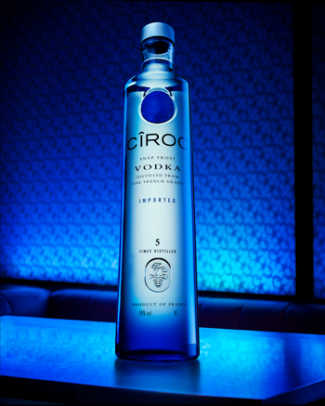
Alcohol Content
Beer 2–6% alcohol
Cider 4–8% alcohol
Wine 8–20% alcohol
Tequila 40% alcohol
Rum 40% or more alcohol
Brandy 40% or more alcohol
Gin 40–47% alcohol
Whiskey 40–50% alcohol
Vodka 40–50% alcohol
Liqueurs 15–60% alcohol

Slide 9
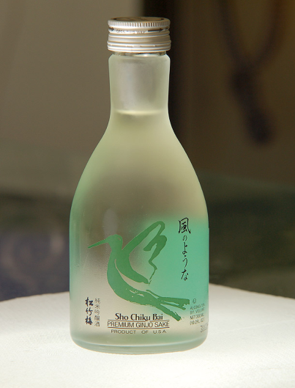
How did Alcohol start?
Fruit juice and honey have been used to make alcohol for thousands of years.
Fermented beverages existed in early Egyptian civilization, and there is evidence of an early alcoholic drink in China around 7000 B.C. In India, an alcoholic beverage called sura, distilled from rice, was in use between 3000 and 2000 B.C.
The Babylonians worshiped a wine goddess as early as 2700 B.C. In Greece, one of the first alcoholic beverages to gain popularity was mead, a fermented drink made from honey and water. Greek literature is full of warnings against excessive drinking.

Slide 10
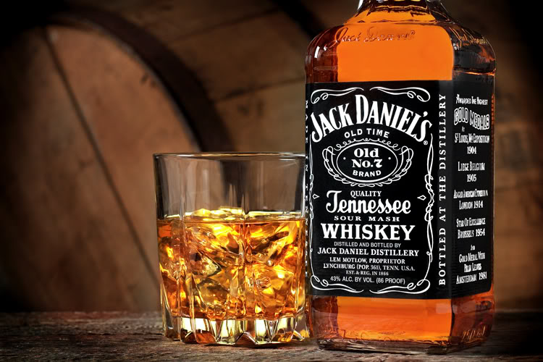
Is alcohol a stimulant?
Although classified as a depressant, the amount of alcohol consumed determines the type of effect. Most people drink for the stimulant effect, such as a beer or glass of wine taken to “loosen up.” But if a person consumes more than the body can handle, they then experience alcohol's depressant effect.

Slide 11
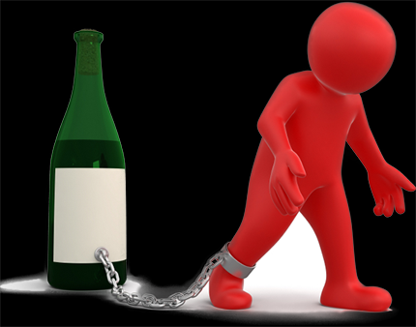
Alcohol
A lot of people are stuck to alcohol some people just cannot stay away. Alcohol is a addicting drug, its very hard for people to try to stop
As a matter of fact alcohol is probably the most widely used drug in America. An interesting fact, 55% of the inmates that are in prison in the United States, over half them are in there because of some alcohol related crime.

Slide 12
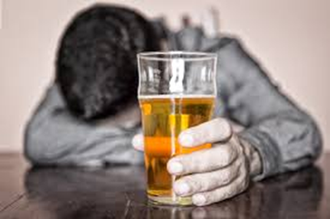
Long term effects
Disrupts normal brain development;
Liver damage and cirrhosis of the liver;
Brain cells die, decreasing brain mass;
Stomach and intestinal ulcers and destroyed organs;
Blood pressure increases, causing heart disease, heart attack, or stroke;
Male sperm production decreases;

Slide 13
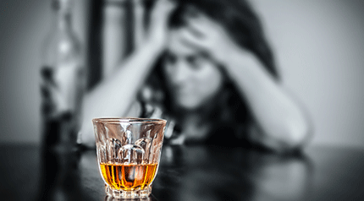
Short term effects
Alcohol poisoning
- Slurred speech
- Drowsiness
- Vomiting
- Diarrhea
- Upset stomach
- Headaches
- Breathing difficulties
- Distorted vision and hearing
- Impaired judgment
- Decreased perception and coordination

Slide 14
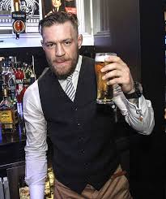
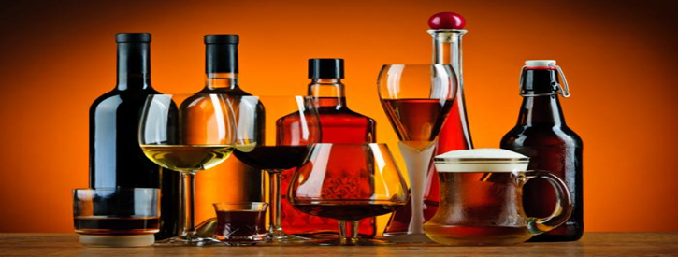
Thank you
national institute of drug abuse (NIDA)
https://www.drugabuse.gov/drugs-abuse/alcohol
Drug free world
www.drugfreeworld.org
Alcohol and public health
www.cdc.gov/alcohol
Narconon
www.narconon.org/drug-education/videos/is-alcohol-a-drug.htm

